Slide 1


n-Bridge Information Factories
Project Start Architecture
Author: Prabhat Kumar
Version: v2.0
Date: 2023-09-22
Key Consultants: Guido Helder, Harry Coopmans, Aaron Van Dam

Slide 2
Reading Guide
Introduction In this section an introduction to the project, its goal, background and scope is given. The impacted functional domains are indicated.
Business architecture Describes the main business requirements and explains how the supported products relate to the reference architecture.
Process architecture Describes the business functions and related processes.
Information architecture Describes the business object models, the information models and data aspects.
Application architecture The application architecture current state and end state are depicted, the changes between these states are described. Also design decisions are explained.
Infrastructure architecture Describes the technology choices that have been made, the infrastructure requirements and attention points. Also, the technical design decisions that already have been taken, are explained.
Migration Describes the intermediate steps between the current and the target architecture
Risk Describes the AIC code and the security attention points of the relevant applications.
Impact on Operations Describes the impact on IT Operations.
Document Control Contains information about the history of the document, the sign offs and references.
Notes:
To avoid an excess of (technical) details in this PSA:
Include only the changes that are relevant from an architecture perspective;
The PSA is not meant as base line documentation;
PSA can include open points to be solved in a later iteration
Major changes require updated versions of PSA:
A new or updated application service with respect to functionality
Change to business, process, application architecture and/or infrastructure (e.g. new component)
Significant functional / technical change
Change in the AIC rating
Rabobank specific packaged software modifications (“Rabo-special”)
Consolidation of applications, databases
Organizational changes (new users or locations)
Support/maintenance window changes
A solution that does not comply to the standards or the applicable Reference Architecture
It is not obvious in which application to solve a new requirement
“Definition of Ready” requires confirmation by the team that all architectural issues are addressed.
Keep in mind that beside the main topic of this PSA there are other secondary topics that may require attention. For example:
Enterprise content management:
Document management: capture, retention (due to policies and including archiving), disposal
Data life cycle
Data feeds to DWH’s (Management Information).
Data feeds to Compliance monitoring: interfaces with fraud, sanction, CDD scanning, anti money laundering, market abuse and conflicts of interest.
Compliance impact (Sox, BCBS, DFA, EMIR, MiFID etc.)
Batch service to other data domains / data logistics: feeds to/from your domain datahub (data exchange to/from the central datarouter).
Business Activity Monitoring: interfaces with the business activity monitoring process.
Billing information: interfaces with clientbilling.
Claims: interfaces with complaints handling.
Financial administration: interfaces with the ledger.

Slide 3



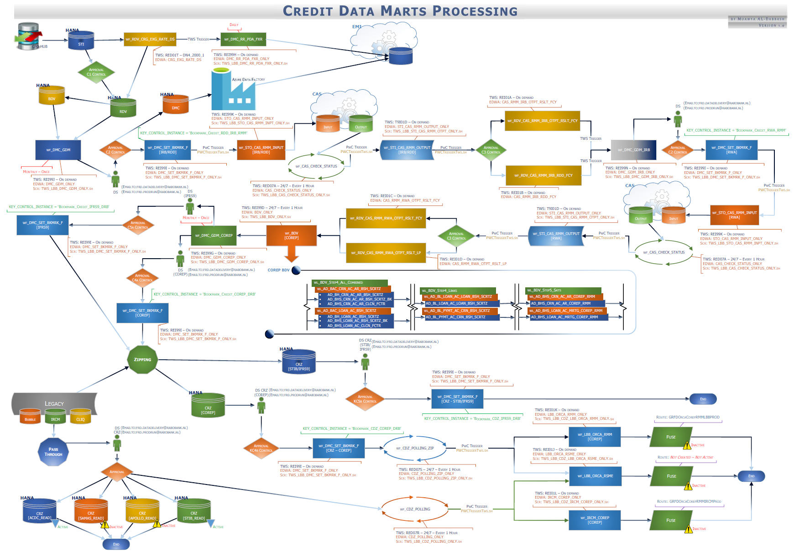
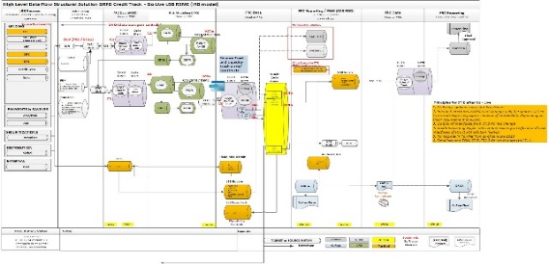
1.1 Introduction (1/2)
Situation & the complication?
Situation
Complication
Question
For producing regulatory and internal reports, booking of IFRS9 provisions and performing baseline stress testing, within Rabobank a series of credit model calculations needs to be performed every month. To do this, Rabobank Risk & Finance needs:
to gather data,
to run model calculations,
to inspect and sign off data
The current system setup and TOMs for running IRB and ECL models are diverse and complex.
Running the IRB/RWA batches alone leads to complex operating models – see below snippet.
Current setup causes unapproved data to already be ingested in GRFD
Role of GFRD/O2 has grown beyond data warehousing to include orchestration of calculations and key controls
Complexity will increase when integrating ECL, Basel IV,RAROC, baseline stress test into the monthly credit risk calculations.
Many areas of the affected IT Landscape are already undergoing drastic changes such as:
DART & Stress Test is migrating to cloud and to CAS platform
A new regulatory reporting platform to perform external reporting
RML (existing IRB models are being revamped) is affecting the Credit Risk IRB models
Oxygen is implementing GRFD as the replacement of multiple R&F data warehouses,
Complication/challenge is to define right solutions on this dynamic Risk & Finance Architectural Landscape by balancing between tactical/legacy implementations and aiming for structural solutions, considering feasibility of implementation
How to implement an integrated approach to coordinate the following in a manageable way?
running and orchestrating:
1. calculations
2. inspections
3. sign offs
4. retrieval and delivery of the data
With responsibilities clearly separated for all these aspects ?
RMM
RSME
1. Introduction
Notes:
Elevator pitch PSA; the essentials of why we are doing this. Give a short introduction by addressing:
Region, Entity, Business Line
Timelines
Impact
Dependencies
Domain architecture
Roadmap
Provide a short description of the:
Objectives,
Business functions,
Business drivers,
Reasons and/or problem description

Slide 4
1.2 Model calculation becoming more interdependent
new models => more complex dependency chain
The dependencies between the Credit Risk Calculations is already complex (see below) and it’s only going to increase with new calculations (like SA-RWA). See right for an overview of future state dependencies. Traditionally, the model orchestration is done by a variety of different parties, Tribe Data foundation (GRFD, LBB Bubble etc), Tribe Credit Core (CAM), Tribe Credit Analytics (DART, STIB). With nBIF being positioned as the IT system to do end to end n-Bridge run, The orchestration responsibility moves completely to Tribe Credit Analytics.
1. Introduction
Notes:
Use this section to give some background of the project for the reader by means of:
Setting the scene
Outlining the strategy
Describe the IT impact

Slide 5



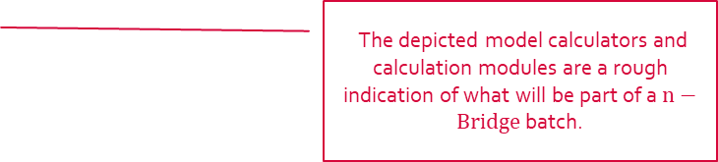
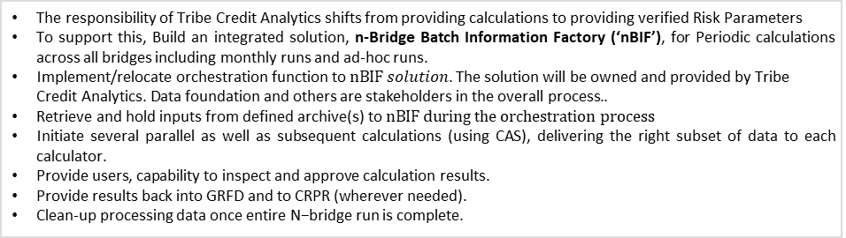
1.1 Introduction (2/2)
The n-Bridge Information Factory (nBIF) proposal
Proposal
Goals
The responsibility of Tribe Credit Analytics shifts from providing calculations to providing verified Risk Parameters
To support this, Build an integrated solution, n-Bridge Batch Information Factory (‘nBIF’), for Periodic calculations across all bridges including monthly runs and ad-hoc runs.
$\text{Implement}\text{/}\text{relocate} \text{orchestration} \text{function} \text{to} nBIF solution\text{. }\text{The} \text{solution} \text{will} \text{be} \text{owned} \text{and} \text{provided} \text{by} \text{Tribe} \text{Credit} \text{Analytics}\text{. }\text{Data} \text{foundation} \text{and} \text{others} \text{are} \text{stakeholders} \text{in} \text{the} \text{overall} \text{process}\text{.. }$
$\text{Retrieve} \text{and} \text{hold} \text{inputs} \text{from} \text{defined} \text{archive}\text{(}\text{s}\text{) }\text{to} nBIF during the orchestration process$
Initiate several parallel as well as subsequent calculations (using CAS), delivering the right subset of data to each calculator.
$\text{Provide} \text{users}\text{, }\text{capability} \text{to} \text{inspect} \text{and} \text{approve} \text{calculation} \text{results}\text{.}$
$\text{Provide} \text{results} \text{back} \text{into} \text{GRFD} \text{and} \text{to} \text{CRPR}\text{ (}\text{wherever} \text{needed}\text{).}$
Clean-up processing data once $\text{entire} \text{N}\text{−}\text{bridge}$ run is complete.
Simplified Risk Modeling landscape.
Better lineage (in-turn improved BCBS 239 compliance).
Shorter time-to-insight (reporting timelines).
Improved alignment and consistency across bridges
Allocate roles and responsibilities where they belong
GRFD
CAS
Model Calculator 1
M.C. 2
M.C. 3
M.C. 4
M.C. 5
IRB
ECL
RWA
ST
RAROC
The depicted model calculators and calculation modules are a rough indication of what will be part of a $n−Bridge$ batch.
CADDI
‘nBIF’
CRPR
ECL Manual Override?
E(T)L
E(T)L
Work DB and I/O DBs
E(T)L
Inspect (bi)
CFO
HUB
Approve
Orchestrate/workflow/schedule
Dashboard?
Reporting
RRP
Legacy Rep.
1. Introduction
Notes:
Elevator pitch PSA; the essentials of why we are doing this. Give a short introduction by addressing:
Region, Entity, Business Line
Timelines
Impact
Dependencies
Domain architecture
Roadmap
Provide a short description of the:
Objectives,
Business functions,
Business drivers,
Reasons and/or problem description

Slide 6
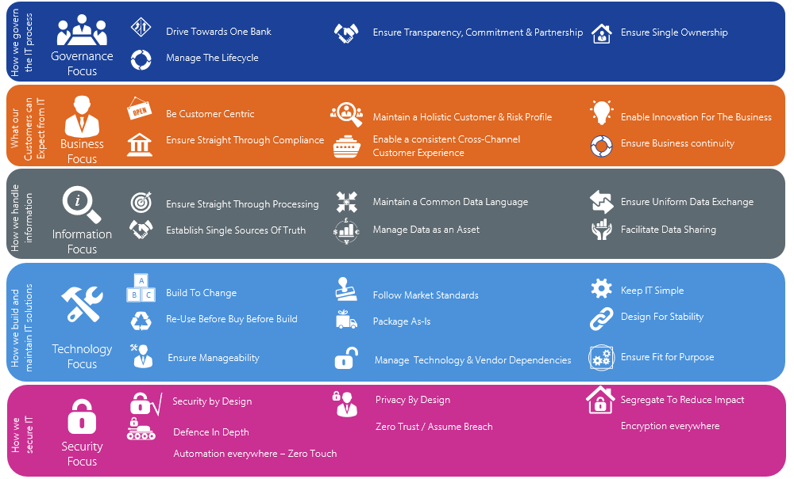
1.3 What Principles to adhere?
For more information see 10.3 General references; link to the Rabobank Enterprise IT Architecture Principles.
1. Introduction
Notes:
You can replace the overview for a list of the most important principles for this change and ad to each one an explanation OR mention all the important principles in the pages of the ‘Architectural Decisions’ and remove this slide.
If you can’t fulfill an applicable principle make note of it in the slide ‘Architectural deviations’.

Slide 7
1.6 Scope
Business aspect | In Scope | Out of scope
Customer segments | RMM, RSME, Corporate, Rural, OP portfolios, Non-IRB models, Vista, RMAN, Obvion, IPRE, PF, COSAS, FS | DLL
Calculations | IRB, RWA, Basel IV SA RWA , ECL, RAROC & ST, B-RDD | EWS, Climate risk, Collateral eligibility calculation
Processes | UT5 to UT 13: Monthly Accounting & Reporting, UT8, UT14 [Model Monitoring, Calibration & Re(development)] UT3 (CRC triggers) and UT4 ( SAM - latest PD/RRR ) – nBIF positively impact these UT’s by making risk parameters directly available in CRPR | UT1 & UT2 [online]
User groups | Credit Analytics/RME , Data Foundation, Credit core | External Reporting ; & Internal Reporting
IT aspect | In Scope | Out of scope
Applications | nBIF Data Management, Orchestration of Model calculators and validation of risk parameters for UT5, UT8, UT9, User Interaction – Inspection & correction etc. Impact to existing application: CAM, GRFD, CFO Hub, CRPR etc. | Decommissioning of model orchestration functions from GRFD LBB Bubble
Middleware | Data sourcing from GRFD to nBIF . Data provisioning to GRFD, CRPR etc. from nBIF | Data Sourcing from Golden Sources to GRFD, Credit Data Zipper, LBB bubble etc.
Infrastructure | Data storage, Data logistics Workflow Orchestrator for nBIF User Interface for Inspection, ad-hoc runs etc | Calculator platform (CAS)
1. Introduction
Notes:
The scope of a project is essential for the architecture: a too narrow scope will result in a suboptimal solution that will have a difficult fit in the landscape and will not be sustainable over time. A too broad scope will result in project management difficulties and a solution that might not be sufficiently flexible over time.
Provide a short description of the business scope of the project (focus on related business processes, applications, geographical scope and users/stakeholders). Provide a short description of impact on Customer segments
Products, Channels, Processes, Usergroups/Roles and Applications.
Describe the IT scope by indicating impacted applications, interfaces and/or infrastructure. Please give a short summary in this section, it doesn’t have to be a complete detailed list. The complete and detailed list can be given in other sections and/or documents.

Slide 8
1.7 Overview of nBIF PSA and related PSA’s
The goal of this PSA is to describe the role and positioning of n-Bridge in RML Model chains.
nBIF PSA affects the solutions in below PSA
PSA CORP
PSA RMM
PSA RSME
PSA RURAL
PSA SL&I
PSA ST
PSA IFRS9
PSA Basel IV
Model Use
IRB & IRB-RWA
Model Use
IRB & IRB-RWA
Model Use
IRB & IRB-RWA
Model Use
IRB & IRB-RWA
Model Use
IRB & IRB-RWA
Model
Use – UT8
Model use
ECL – UT9
Model Use
SA-RWA
GRFD Blueprint
GRFD Go2
PSA MDS Actualisation
PSA CADDI
PSA CAS Calculator
CAS Usage Patterns
PSA Collateral Eligibility Engine
PSA CRPR
Data
warehousing
Data
warehousing
Model
Monitoring &
Redevelopment
Data Staging-In from GRFD to CA
Model
Calculation
Usage Patterns
Risk
Administration
Risk
Administration
8
1. Introduction

Slide 9
1.8 Functional Domain impact
Enterprise Governance
Organization strategy
Investor relation management
Compliance and risk governance
Value chain management
Data governance
Portfolio management
Project portfolio management
Sustainability policy development
Interaction Management
Customer engagement
Product and Agreement Management
Risk, Finance and Compliance Management
Research and Development
Marketing
Lending
Asset management
Payments
Risk management
Conversation management
Treasury management
Account and Sales Management
Customer Service and Transaction Request Management
Financial markets
Insurance
Non financial services
Channel management
Financial accounting
Reporting
Authentication management
Partner Management
Involved Party Management
Partner
agreement management
Partner agreement execution
Involved Party information management
Involved Party relationship information management
Compliance management
Organization Support
Audit servicing
Human resource management
IT development & operations
Communication
Management reporting
Fiscal and legal support
Document management
Procurement
Facility management
Data management
Model management
1. Introduction
Notes:
Mark the affected/impacted function(s) with boxes and/or a line with dots. You can use multiple boxes if needed.

Slide 10
1.7 nBIF Indicative plateaus
Complete
In Progress
Planned
This roadmap showcase only those milestones that involve nBIF.
nBIF Platform
Platform Release 2
Parallel development blueprint
Inspection Module
Platform Release 4
nBIF ad-hoc run instances
Platform Release 3
nBIF UT5 dummy as a product
nBIF 365 – extend UI features
Platform Release 5
nBIF 365 with Ad-Hoc run console
MVP
Platform Release 1
Base Platform for RSME needs
RSME nBIF
RSME UT5 (IRB + RWA (B3))
with single call from GRFD
RSME UT5 + UT9 +UT8 ( ST Baseline)
MVP
RSME UT5 + UT9 (IFRS9)
RSME UT5 with double
loop from GRFD for IRB & RWA (B3)
RSME UT5 + UT9 with RWA Basel 4
RMM & CF nBIF
Obvion UT5 (IRB + RWA (B3))
RMM UT5 with B4
RMM UT5 (IRB + RWA (B3))
CF UT5 with B4
CF UT5 (IRB RWA+SA RWA(B3))
Obvion UT5 with B4
Corporate & Rural nBIF
Corp (DRB+W&R) UT5 with B3
Corp UT5 with B4
RURAL RWA with B4
RURAL IRB v2.0 + RWA with B4
SL&I nBIF
IPRE RWA with B4
PF RWA with B4
SOV & FI RWA with B4
SL&I DRB RWA with B4
Roadmap for IFRS9 & Stress testing on nBIF is yet to be defined. RSME IFRS9 is first on nBIF so logically ST on nBIF will be built first for RSME.
1. Introduction

Slide 11
1.11 Open issues
Id. | Description | To be closed
1 | Structural solution for registering intermediary results for Model Monitoring. In the target architecture MM store is the fully validated archive where the full calculations (input / intermediary / output) are registered. Model monitoring only needs validated risk metrics in structured format. nBIF fits well for that purpose in relation to batch runs. The role of nBIF in feeding the MM Store is still an open point, and will be addressed in the PSA for MM Store The solution on go-live for MM Factory is that CAS data gets stored in the Calculation Archive, and from there it is retrieved by the MM Factory. nBIF doesn't play a role in this process. | In the UDS Stage 3 design
2 | Incorporation of a correction module in the business process : A correction module will be part of nBIF , which allows business users to correct calculated Risk Parameters. Depending on the outcome of the TOM discussion, it will be added to the business function model. This includes the assignment of a business user (role) to the Risk Parameter correction business function. | Via a separate architecture note on nBIF correction module
3 | Technology choice of the correction module: A final decision has yet to be made between PowerApps or Azure WebApps . Since nBIF is set up modular, this doesn’t impact the realisation of the rest of the application | Via a separate architecture note
4 | Technical Architecture for the ad-hoc run console within nBIF 365 : Since this is not a must have solution, this doesn’t impact the realisation of the rest of the application including ability to do ad-hoc runs on nBIF platform. | In a subsequent version of the PSA
5 | Stress testing has dependency on prudential backstop (PB)calculator. This calculator is maintained by Credit Core. A decision is needed to include PB calculator a part of n-Bridge. | In a subsequent version of the PSA
6 | Supporting data needs of Stress testing reports in intermediate phase. Eventually every ST reports be done by tribe External reporting in target situation. During the intermediate period they need to be supported by Stress Testing. An Information flow from nBIF to ST Information factory (in plan) need to be designed. | In the PSA of ST Information Factory
1. Introduction
Notes:
On this slide the architecture points are listed that require attention in the sequel of this change.

Slide 12
1.12 Architecture deviations
There are architecture deviations that are maintained separately but have direct impact to nBIF. Below list contains such Architecture deviations for completeness along with the reference location where they are managed.
Nr | Description | End date | Reference | Owner
1 | CAM will continue to be playing the role of Orchestrator and data management layer for Rural monthly batch run – UT 5 | Until the Rural model redevelopment to version 2 | TBD | Area Rural
2 | B-RDD model for RSME will continue to be orchestrated by C-RDD application. nBIF will collect the results and use for IRB model run. | RSME B-RDD model shall merge with IRB RSME model & C-RDD application shall be decommissioned. Role of transaction data sourcing be moved to CADDI. An end date is to be identified in RSME specific PSA. | TBD | Area RSME
3 | nBIF will transfer ECL results to STIB for post processing IFRS9 business processes, like “Preparation of ledger bookings to support FinRep”. | Until the movement of post processing IFRS9 business processes to strategic solutions. | Decision document IFRS9 migration to nBIF v1.0.pptx | Area Provisioning & Reporting
5 | Direct exchange of data between nBIF & IFRS9 Information Factory for various purposes. For ex – “Origination PD Curve cache” , “MES Data Cache”, “to support execution of secondary runs which still happen through IFRS9 information factory”. | In subsequent plateaus, that are yet to be plotted, nBIF will directly ingest the data needed for IFRS9 and is not available through GRFD route. | Decision document IFRS9 migration to nBIF v1.0.pptx | Area Provisioning & Reporting
5
1. Introduction
Notes:
Registered Deviations include deviations from:
EA principles
EA standards
Current policies / legislation / regulation
The financial framework

Slide 13
Business Architecture
n-Bridge Information Factory
2. Business

Slide 14

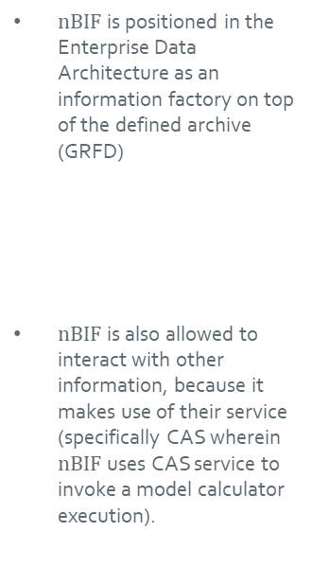
2.1 Positioning of nBIF in “Enterprise Data Architecture”
Enterprise Data Architecture
$nBIF$ is positioned in the Enterprise Data Architecture as an information factory on top of the defined archive (GRFD)
$nBIF$ is also allowed to interact with other information, because it makes use of their service (specifically CAS wherein $nBIF$ uses CAS service to invoke a model calculator execution).
Primary Processes
/ Sources
Enterprise Data Lake
Information Factories
Actual Data
Streaming Data
Raw Archives
Definition Factories
Defined Archive
Other Information Factories
Customer
Raw Data
Defining & Curating data
Defined Data
EDA:
Any Type of Structured & Unstructured data
Value Chain
$$nBIF$$
Market
Raw Data
Defined Data
Information Factories using Risk Models
Information Factories Risk
Information Factories Risk
Product
Raw Data
Defining & Curating data
Defined Data
GRFD:
Fully Validated Structured Data
Value Chain
Transaction
Raw Data
Defined Data
External
Raw Data
Defining & Curating data
Defined Data
HISDA:
Strictly Protected (historical) Data
CAS
Value Chain
…
Raw Data
Defined Data
Data Labs
Advanced Analytics & Intelligence (Data Research)
Development of Data- & Information Products
One!Lab
2. Business
Notes:
Describe how the change is positioned within the domain reference architecture and how the change attributes to realizing the domain reference architecture.

Slide 15
2.2 High level business requirements
Allocate roles and responsibilities where they belong
GRFD focusses on data warehousing;
Model Management takes responsibility for the orchestration and data logistics between use tests;
CAS performs model calculations
Support RtC roadmap implementation
The roadmap must always be aligned with RtC plan.
Simple, modern & future-proof credit risk model landscape
Solution must be modular by design.
Model dependencies are defined at the orchestration layer instead of having it baked-inside the application.
De-coupled data workspace for each bridge/FT
Improved alignment and consistency across bridges
Methodological changes assessed over all use tests before release to production
Standard approach & solution for approval
Single platform for all signoffs
Improve [run] performance
along with IRB and IFRS9 calculations, ST baseline calculations shall be performed monthly.
Multiple Use Tests must be able to run batch jobs simultaneously.
Reduction of multiple system interconnects (e.g., grfd to cas to grfd to cas to grfd …) to reduce data checks and transfer delays.
Prevent unnecessary calls and data transfers
Faster response to changing requirements
Having data closer to the calculators.
Models should be modular.
Design with Future in mind
New Tactical solutions shall be avoided at all cost.
The design constructs can be leveraged in future to realise self-service kind of impact analysis.
Reduce dependencies on data chain
reconciled dataset over all bridges (by design) and improvement of data lineage
Taken as-is from BRD nBridge Information Factory v1.0
2. Business

Slide 16
2.3 nBIF Business Architecture
Birds eye view on nBIF collaboration with major applications of Tribe Credit Analytics, Tribe Data Foundation & Tribe Credit Core.
<------------------- Tribe Credit Analytics ------------------->
Golden Sources
Calculation Platform (CAS)
Tribe Data Foundation (GRFD)
Model Calculator 1
MC 2
MC 2
MC 2
MC 2
irb
ECL
RWA
RAROC
ST
Business User
STI
Staging In
DAL
(Data Access Layer)
Deliver
Verified Risk Metrics
RDV
Raw Data Vault
CADDI
(Credit Analytics Data Disclosure)
Orchestration Platform (nBIF platform)
Tribe Credit Core
(CRPR)
nBIF (n-Bridge Information Factory) Instance
nBIF 365
n-Bridge Information Factory (nBIF)
Inspect (bi)
Correct
Orchestrate/workflow/schedule
Approve
BDV
Business Data Vault
STI, Work DB and I/O DBs
E(T)L
Ad-Hoc run
Tribe Data Foundation
(to GRFD
via CFO-Hub)
`f(x)
F(x)
F(x)
STO
E(T)L
F(x)
F(x)
Via
Respective STO
Deliver
Verified Risk Metrics
Tribe Internal Reporting
Tribe External Reporting
Model Monitoring
(MM Store)
There will be multiple nBIF instances on nBIF platform.
Each nBIF instance is a separate IT application that implements an n-Bridge (orchestration chain of one or more models).
The nBIF platform (aka. orchestration Platform ) is responsible to deliver capabilities to build nBIF instances with reusable infra-as-a-code, reusable Identity and access framework, standard development framework, common data management framework, template for model orchestration.
nBIF platform also deliver products that are used by multiple nBIF instances like nBIF 365, which is a user interface for multiple capabilities including Inspection.

Slide 17
2.4 Business viewpoint for Parallel development requirements
Supporting multiple portfolio’s to be able to build their nBIF at the same time independently.
nBIF must have an architecture that enable multiple portfolios to build end-to-end n-Bridges concurrently & independently.
nBIF must also enable models to build/deploy their model specific orchestration changes independently.
Provide Model-Factories
For each bridge and portfolio combination (e.g., IRB RSME, IFRS9 RSME), there shall be an isolated implementation environment (a “Model-Factory”) that is integrated into the nBIF instance. Squads can build and deploy their respective orchestration, data management and other application processes within a model factory, independent from the developments in other model factories.
Standard mechanism to connect Model-Factories
A portfolio area should be able to implement as many bridges as possible independently (preferably all). This portfolio level mechanism shall also be responsible for connecting model factories with GRFD and other external sources/consumers
Bridges
IRB
IFRS9
RWA
etc.
RSME
FT
FT
RMM
FT
FT
CORP
FT
FT
Portfolios
FT
FT
RURAL
FT
FT
etc.
2. Business

Slide 18
2.5 Business viewpoint for ad-hoc production runs
In addition to monthly factory run, there is a need to support multiple other n-Bridge runs with production data (hereafter, ad-hoc production runs).
To support such runs, separate nBIF instances will be built within production environment of nBIF platform.
The number of such nBIF instances can be different for different portfolio depending upon their needs.
G
R
F
D
C
A
D
D
I
RSME nBIF instances – Illustrative view
CRPR
nBIF instance for Factory runs
IRB
ETL
ECL
ETL
RWA
ETL
ETL
ST (Baseline)
RAROC
nBIF instance for Ad-hoc candidate model runs
GRFD
(via CFO Hub)
nBIF instance for Ad-hoc stress testing runs
etc.…
Examples of ad-hoc production runs
Ad-hoc production run of candidate models
Ability to execute candidate models with production data for impact analysis before promoting as a model for monthly runs to be used for reporting.
Ad-hoc production runs for regulatory needs (ex – EBA) or periodic Stress testing needs
A business owned, IT governed solution that provides ability to execute [un]modified n-Bridges with [un]modified production data.
The solution shall allow executing side by side without replacing structurally implemented monthly baseline run solution.
The solution shall enable function analysts to interact with it without needing expert IT knowledges.
2. Business

Slide 19
2.6 High level business requirements for Ad-Hoc runs
Stress Testing has most recurring ad-hoc run requirement. Since these ad-hoc runs has the most extreme end of business requirements, they are used as the basis to deliver nBIF ad-hoc run environment. By doing so, ad-hoc run requirements of other models shall also be covered.
Data Sourcing​
It should be possible to consume data from external systems on need basis e.g. EPC level data from Cal CASA​
Data Preparation and Data Processing
It must be possible to manually intervene the Stress Test run, if required , to analyse the input/output during data preparation/processing, apply data adjustments required as per regulatory requirements.
Data delivery & Consumption
It should be possible, when needed, to deliver the result of ad-hoc runs to production environments of downstream systems like GRFD & CRPR in a controlled way.
Environment
An environment in which tests can be built based on production data, where modified models (frequent changes based on regulatory/scenario requirements), several parameter settings and other modifications can be tried out (Data Analyses, Model Analyses, Inputs and Results).​
An environment where outcomes are published, where slicing and dicing can be done, and in which sufficient information on used data inputs and models is available.​
An environment with secured/restricted access to store outcomes of production runs prior to publication (KPI/Insiders compliance)​
An environments to enable research/LAB activities including use of non-approved model parameters, scenarios and other testing inputs using production data.​
An environment should support running different model versions of ST Calculator ((frequent changes based on regulatory/scenario requirements).​
The non-ST calculators (IRB/IFRS 9/ RWA/Prudential Backstop) are owned by respective model teams. They may undergo changes due to business and architecture requirements. It is possible that a particular ST scenario, during development/test runs, may use the specific version of non-ST calculator considering business/data requirements and model stability.
Requirements derived from Stress Testing - Target State on nBIF.pptx section 2.2 with ST scenario type - “External/Adverse ST Runs”
Note- In contrary to widespread assumption that adverse scenario runs must happen at once for every portfolios, ST stakeholdes confirm portfolio wise ad-hoc runs are sufficient. ST will implement separate solution to collate results of different portfolio for the purpose of consolidated reporting.
2. Business

Slide 20
Process Architecture
n-Bridge Information Factory
3. Process

Slide 21
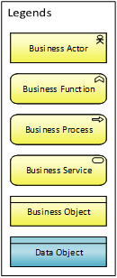
3.1 n-Bridge Monthly run - Target Business process view
Scope of this PSA
In this view the following target Business Functions have been included:
Defined Data Management: Providing complete defined data
Model Execution: Responsible to Execute Risk models
Data disclosure: Responsible to execute data acquisition
Model Orchestration: Responsible for Data management of Model i/o data And Providing verified risk metrics
3. Process
Notes:
Provide a high level graphical overview of the process(es) impacted by the project. For this diagram the Business Process Viewpoint of Archimate is used.
The Business Process Viewpoint is used to show the high-level structure and composition of one or more business processes. Next to the processes themselves, this viewpoint contains other directly related concepts, such as:
The services that a business process offers to the outside world, showing how a process contributes to the realization of the company’s products
The assignment of business processes to roles, which gives insight into the responsibilities of the associated actors
The information used by the business process

Slide 22
3.2 n-Bridge Monthly run - Tactical Business process view
GRFD1 being the provider of STO | Applicable to RSME & RMM
Scope of this PSA
In this view the following target Business Functions have been included:
Defined Data Management: Providing verified model input data
Model Execution: Responsible to Execute Risk models
Model Orchestration: Responsible for Data management of Model i/o data And Providing verified risk metrics
3. Process
Notes:
Provide a high level graphical overview of the process(es) impacted by the project. For this diagram the Business Process Viewpoint of Archimate is used.
The Business Process Viewpoint is used to show the high-level structure and composition of one or more business processes. Next to the processes themselves, this viewpoint contains other directly related concepts, such as:
The services that a business process offers to the outside world, showing how a process contributes to the realization of the company’s products
The assignment of business processes to roles, which gives insight into the responsibilities of the associated actors
The information used by the business process

Slide 23
3.2 n-Bridge Monthly run - Tactical Business process view
GRFD2 being the provider of STO || Currently applicable to CF, Rural, FS and SL&I portfolios
Scope of this PSA
In this view the following target Business Functions have been included:
Defined Data Management: Providing verified model input data
Model Execution: Responsible to Execute Risk models
Model Orchestration: Responsible for Data management of Model i/o data And Providing verified risk metrics
3. Process
Notes:
Provide a high level graphical overview of the process(es) impacted by the project. For this diagram the Business Process Viewpoint of Archimate is used.
The Business Process Viewpoint is used to show the high-level structure and composition of one or more business processes. Next to the processes themselves, this viewpoint contains other directly related concepts, such as:
The services that a business process offers to the outside world, showing how a process contributes to the realization of the company’s products
The assignment of business processes to roles, which gives insight into the responsibilities of the associated actors
The information used by the business process

Slide 24
3.2 n-Bridge Ad-Hoc run – Indicative Target Business process view
Scope of this PSA
In this view the following target Business Functions have been included:
Defined Data Management: Providing complete defined data
Model Execution: Responsible to Execute Risk models
Data disclosure: Responsible to execute data acquisition
Model Orchestration: Responsible for configuring ad-hoc n-Bridge run, Data management of Model i/o data, And Providing verified risk metrics
3. Process
Notes:
Provide a high level graphical overview of the process(es) impacted by the project. For this diagram the Business Process Viewpoint of Archimate is used.
The Business Process Viewpoint is used to show the high-level structure and composition of one or more business processes. Next to the processes themselves, this viewpoint contains other directly related concepts, such as:
The services that a business process offers to the outside world, showing how a process contributes to the realization of the company’s products
The assignment of business processes to roles, which gives insight into the responsibilities of the associated actors
The information used by the business process

Slide 25
3.2 Special points and/or impact on data/secondary processes
Secondary process | Business object | Impact
Compliance monitoring | ….. | < Concerns the (continuity of the) connection with the mandatory compliance monitoring process. Overthink all the compliance theme’s: Fraud, Sanction, CDD scanning, Anti Money Laundering, Market Abuse and Conflicts of Interest. >
Data Logistics and Management Information | Credit Risk Metrics -- IRB EAD, LGD, PD, IRB RWA, SA RWA, ECL, RAROC & Stress Testing. | nBIF will become responsible for delivering credit risk metrics to the Risk & Finance landscape including CRPR, GRFD(via CFO Hub) etc.
Business Activity Monitoring |  | < Concerns the (continuity of the) connection with the business activity monitoring process. Overthink this primarily from the view of a transaction flow. >
Provide billing information |  | < Overthink and argument if you have to feed the client billing application with appropriate data. Define and tune the interface with the owner of the billing application. >
Product claims / exception handling |  | < Overthink and argument if you need to change or build an interface with a (workflow) system for handling complaints. >
Financial administration |  | < CRG requires to feed the ledgers via the new data logistics infrastructure. Follow the approach as by ‘Data Logistics and Management Information’ >
Compliancy to the financial framework |  | < Describe the impact and get your approvement from the financial architects >
Sox-compliancy | nBIF Component Credit Risk Metrics -- IRB EAD, LGD, PD, IRB RWA, SA RWA, ECL, RAROC & Stress Testing. | TOM/Control Framework: nBIF components need to be added to the control framework. e.g. Bookmarks, archer controls
3. Process
Notes:
Keep in mind that beside the main topic of this PSA there are other secondary topics that may require attention. Think over all possible related processes.
Fill in the columns if applicable. Fill in with ‘not applicable’ if not applicable.
Possible subjects:
Enterprise content management:
Document management: capture, retention (due to policies and including archiving), disposal
Data life cycle
Data feeds to DWH’s (Management Information).
Data feeds to Compliance monitoring: interfaces with fraud, sanction, CDD scanning, anti money laundering, market abuse and conflicts of interest.
Compliance impact (Sox, BCBS, DFA, EMIR, MiFID etc.)
Batch service to other data domains / data logistics: feeds to/from your domain datahub (data exchange to/from the central datarouter).
Business Activity Monitoring: interfaces with the business activity monitoring process.
Billing information: interfaces with clientbilling.
Claims/exception handling: interfaces with complaints handling.
Financial administration: interfaces with the ledger.

Slide 26
Information Architecture
n-Bridge Information Factory
4. Information

Slide 27
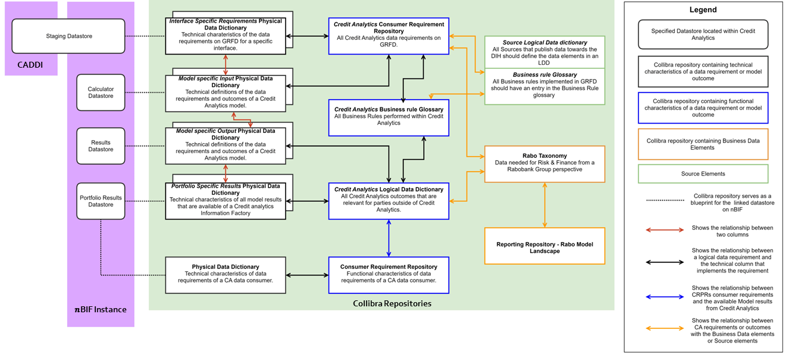
4.1 Data architecture (1/3)
Data Governance Aspect | Project impact
Metadata: Data model & Definitions | Business metadata that include Data model and Data definition of every dataset present on nBIF is defined and published in Collibra using the concepts (CRR – Consumer Requirement repository, LDD – Logical Data Dictionary & PDD-Physical data dictionary). See below for more info.
Find more detailed guidelines at
Credit Analytics - Data Lineage and Collibra - Tribe Credit Analytics - Confluence (rabobank.nl)
4. Information
Notes:
On this slide describe the main features and decisions with respect to the enterprise data architecture topics. In particular:
Meta data
Check if relevant data models (logical and physical) are available (where PowerDesigner is the Bank’s standard tool) and describe in this paragraph)
Or identify which new data models to create
Provide data definitions in Collibra
Data Lineage
Documenting Data lineage should be taken into account in all new systems and system updates
Some system & data technologies allow lineage information to be extracted automatically through the use of Informatica tooling.
Data Quality Issues:
Identify (major) DQ issues that are related to this project.
Identify possible DQ improvements resulting from this project.
Data Quality monitoring
The new system should support measuring and reporting the quality of the data
Implementing input controls to prevent data quality issues
Record Keeping
Validate that data retention terms (minimum and maximum) are defined
Describe how data retention and disposal processes are implemented.
Data Delivery
Describe all consumed and produced data sets in Data Delivery Agreements. If covered elsewhere include a reference to it.
Reference and Customer master data management
Identify which reference and master data is required
Examples of reference data are: Industry codes, currency codes, country codes, product hierarchy but also local reference data like Tax reason code (Brazil)
Where available the reference data should be sourced from the global reference data management system and processes (referencedata.rabobank.com)
Describe how local reference data are managed, preferably also via the global tool (referencedata.rabobank.com)
Where customer data is processed, follow the Rabobank Group vision on Customer Master Data Management
Data warehouse / Lake
The Data Lake / DWH architecture requires data to be delivered, at least in raw format
Which data warehouse will store the data

Slide 28
4.1 Data architecture (2/3)
Data Governance Aspect | Project impact
Data Lineage / ETL / Data Delivery | Technical Data Lineage – nBIF will be integrated with Informatica Enterprise Data Catalogue (EDC) to capture end to end technical data lineage. This will be a periodic interface wherein, EDC will read the nBIF codebase to derive & store the technical lineage within EDCs data repository. The derived lineage will be available for access through their web portal. Operational Data Lineage (Process Lineage) – Entire nBIF workflow is driven using a structured metadata framework (MDF) which captures operational metadata (data volume, timing, process step etc) in a dedicated database. Data Delivery - All source applications in scope are SOX compliant for data exchanges. Meaning for all data movement, logging information will be in place and technically we make sure data delivery is ensured. See Inbound/Outbound interface section for measures specific to each interface.
4. Information
Notes:
On this slide describe the main features and decisions with respect to the enterprise data architecture topics. In particular:
Meta data
Check if relevant data models (logical and physical) are available (where PowerDesigner is the Bank’s standard tool) and describe in this paragraph)
Or identify which new data models to create
Provide data definitions in Collibra
Data Lineage
Documenting Data lineage should be taken into account in all new systems and system updates
Some system & data technologies allow lineage information to be extracted automatically through the use of Informatica tooling.
Data Quality Issues:
Identify (major) DQ issues that are related to this project.
Identify possible DQ improvements resulting from this project.
Data Quality monitoring
The new system should support measuring and reporting the quality of the data
Implementing input controls to prevent data quality issues
Record Keeping
Validate that data retention terms (minimum and maximum) are defined
Describe how data retention and disposal processes are implemented.
Data Delivery
Describe all consumed and produced data sets in Data Delivery Agreements. If covered elsewhere include a reference to it.
Reference and Customer master data management
Identify which reference and master data is required
Examples of reference data are: Industry codes, currency codes, country codes, product hierarchy but also local reference data like Tax reason code (Brazil)
Where available the reference data should be sourced from the global reference data management system and processes (referencedata.rabobank.com)
Describe how local reference data are managed, preferably also via the global tool (referencedata.rabobank.com)
Where customer data is processed, follow the Rabobank Group vision on Customer Master Data Management
Data warehouse / Lake
The Data Lake / DWH architecture requires data to be delivered, at least in raw format
Which data warehouse will store the data

Slide 29
4.1 Data architecture (3/3)
Key data governance aspects*
Aspect | Project impact
Data Quality Impact | Data repair actions might be needed to use the data properly for Model calculations. Current guideline is to position only Consuming business rules in Information factory. CAS calculators are preferred place for model specific rules. nBIF can fill-in where the rules affect multiple models or if there are significant performance reasons.
Data Quality Monitoring | Data Quality Control Framework (IDQ) will be extended to nBIF. The DQ report of Critical Data Elements of CAS calculators will be done using data from nBIF. This mean, Informatica IDQ will have interface with each nBIF Instance that is used for monthly production runs. IDQ will connect to nBIF databases to consume all the input data that is used by models and all the model results that are delivered by nBIF. IDQ will perform profiling on these datasets to create DQ report of Critical data elements. Additional DQ rules can be implemented via Azure Data Factory and can be reported on for monthly run inspection purposes.​
Record Keeping | nBIF is an operational system and not a data archive. Limited data history will be maintained within nBIF to support its internal application processes. Ex- Model Inspection step would require operational history. Metadata & log tables will also store history.
Data Delivery agreements | As a result of TOM changes , Data delivery Agreements shall be drawn up between nBIF and impacted systems of this PSA.
Golden Source & Customer Master Data Management | GRFD will be the golden source for nBIF with some deviations that may occur in intermediate situation. For Macro Economic Scenarios – MEISTER will remain the golden source for model calculators.
Data Lake / Warehouse | Data should be sourced from GRFD/CAS. Data will be stored in Azure based nBIF’s Data stores.
*) For more information see 10.3 General references; link to the Data Management Program
4. Information
Notes:
On this slide describe the main features and decisions with respect to the enterprise data architecture topics. In particular:
Meta data
Check if relevant data models (logical and physical) are available (where PowerDesigner is the Bank’s standard tool) and describe in this paragraph)
Or identify which new data models to create
Provide data definitions in Collibra
Data Lineage
Documenting Data lineage should be taken into account in all new systems and system updates
Some system & data technologies allow lineage information to be extracted automatically through the use of Informatica tooling.
Data Quality Issues:
Identify (major) DQ issues that are related to this project.
Identify possible DQ improvements resulting from this project.
Data Quality monitoring
The new system should support measuring and reporting the quality of the data
Implementing input controls to prevent data quality issues
Record Keeping
Validate that data retention terms (minimum and maximum) are defined
Describe how data retention and disposal processes are implemented.
Data Delivery
Describe all consumed and produced data sets in Data Delivery Agreements. If covered elsewhere include a reference to it.
Reference and Customer master data management
Identify which reference and master data is required
Examples of reference data are: Industry codes, currency codes, country codes, product hierarchy but also local reference data like Tax reason code (Brazil)
Where available the reference data should be sourced from the global reference data management system and processes (referencedata.rabobank.com)
Describe how local reference data are managed, preferably also via the global tool (referencedata.rabobank.com)
Where customer data is processed, follow the Rabobank Group vision on Customer Master Data Management
Data warehouse / Lake
The Data Lake / DWH architecture requires data to be delivered, at least in raw format
Which data warehouse will store the data

Slide 30
4.2 Information Architecture decisions
Nr | Description | Relevance
IAD-1 | nBIF implementations are always done portfolio-specific. Single nBIF instance does not calculate credit risk metrics for more that one portfolio. | All portfolio – Ad-hoc & Monthly run
IAD-2 | Data output from nBIF is done per portfolio (and not for all portfolio's at once) | All portfolio – Ad-hoc & Monthly run
IAD-3 | Multiple nBIF production instances will be created for a portfolio to support business needs that require ad-hoc run of their n-bridges with production data.. Each such instance is treated as a separate application. | All portfolio – Ad-hoc runs
IAD-4 | nBIF will be the provider of model calculator results to CRPR directly for IRB, RWA & RAROC calculations. GRFD will receive these credit risk metrics through after traversing via CRPR ->CDM->CFO Hub. | All portfolio – Monthly Factory runs
IAD-5 | For each nBIF instance that uses GRFD1 to source input data, There will be a single STO in GRFD1 for the consolidated data needs of all the models (bridges) on nBIF. | All portfolios– Monthly Factory runs
IAD-6 | For each nBIF instance that uses GRFD2 to source input data, There will be a single STO created on CADDI for the consolidated data needs of all the models (bridges) on nBIF. | All portfolios– Monthly Factory runs
IAD-7 | For each nBIF instance for which STO is created by TCA using CADDI, The Input data validation step will be done on nBIF. This will be a consolidated validation for all the bridges. | All portfolios– Monthly Factory runs
IAD-8 | The calculator results are delivered to downstream consumers only after the result of last bridge of the respective nBIF is inspected and approved | All portfolio – Monthly Factory runs
IAD-9 | nBIF will store operational history of all the data that is needed to perform Input/Output plausibility checks | All portfolios– Monthly Factory runs
IAD-10 | During intermediate situation, nBIF instances may interface directly with data sources other than GRFD (GRFD2). | All portfolios
IAD-11 | nBIF can only expose model outputs (not intermediates) to its data consumers (includes credit core, GRFD, model monitoring, or next bridge in the chain). | All portfolios
IAD-12 | CADDI will always be used in-between GRFD2 & nBIF. This will also include the situations when STO tables are created in GRFD2. | All portfolios– Monthly Factory runs
IAD-13 | For the portfolios where behavioural Risk drivers calculated by UT5 (Batch) is required by UT1, A direct interface between nBIF and EMI will be established. | All portfolio’s having BRDD needs – Monthly Factory runs
IAD-14 | nBIF will ingest monthly increment of Transactions and Balance data and store up to 24 months history of Txn and Balance data that is needed for BRDD calculations | All portfolios
4. Information
Notes:
List all architectural decisions regarding the overall architecture. Please use the following way of thinking: describe the decision, give the reasoning why, describe the consequences and describe mitigations.
It is left to the discretion of the architect whether or not (s)he wants to put 1 decision per slide or more (max 2)

Slide 31
4.2.1 Information Architecture decisions
Go back to the Information Architecture decisions List
IAD-1. nBIF implementations are always done portfolio-specific. Single nBIF instance does not calculate credit risk metrics for more that one portfolio.
Decision | nBIF implementations are always done portfolio-specific. Here, portfolio means TCA rating systems, which are (CF, RMM, RSME, Corporate, IPRE, PF, SOV, FI, RURAL & COSAS )" Single nBIF instance does not calculate credit risk metrics for more that one portfolio. For ex- RSME’s nBIF instance(s) execute n-Bridge only for RSME.
Rationale | By having portfolio wise separation, The nBIF implementation is democratized and fast-tracked. Multiple nBIF's can be built & run in-parallel. Portfolio specific nuances can be handled independently with more flexibility. Portfolio squads are made responsible for their IT and to deliver verified risk metrics for their portfolio Help in decommissioning of legacy systems as incremental modernization is more practical & less disruptive.
Related IT-principle | Keep it simple
Consequences | 1. There are models like IFRS9, Stress Testing which is traditionally executed once for all portfolios. These models shall support portfolio wise execution. 2. There are few application processes (like STIB data pipelines, ST report etc) which is traditionally executed once for all portfolios. They shall be refactored to be portfolio wise. 3. There are business processes that require cross portfolio execution – such business needs will require execution of multiple nBIF instances. 4. Some IT work will be duplicate across portfolios.
Alternatives | Having single nBIF implementations that can execute n-Bridge for all portfolio : The scope of single portfolio’s n-Bridge implementation is already very large & complex. Extending it further will make it so much monolithic that it will become unmanageable.
Architectural Fit | Good
Mitigations | IFRS9 & Stress testing has already adopted portfolio approach to (re)build their calculators. A lot of monolithic application processes are redundant with structural solution using GRFD – nBIF – CASCADE - nBIF platform will build mechanism to reuse duplicate functionalities
4. Information
Notes:
List all architectural decisions regarding the overall architecture. Please use the following way of thinking: describe the decision, give the reasoning why, describe the consequences and describe mitigations.
It is left to the discretion of the architect whether or not (s)he wants to put 1 decision per slide or more (max 2)

Slide 32
4.2.2 Information Architecture decisions
Go back to the Information Architecture decisions List
IAD-2. Data output from nBIF is done per portfolio (and not for all portfolio's at once)
Decision | Data output from nBIF is done per portfolio (and not for all portfolio's at once) If a business processes require consolidation of validated credit risk metrics across multiple portfolio, The consolidation shall be done at downstream systems like CRPR, GRFD, RRP.
Rationale | Keep nBIF manageable Push responsibility where it belong.
Related IT-principle | Keep it simple
Consequences | There are certain use cases that require consolidation of credit risk metrics across all portfolio. An intermediate solution will be needed to support such needs.
Alternatives | Have a data layer on nBIF platform that can be used to store results of individual portfolio nBIFs. Perhaps Common data cache can be that data layer. It is discarded as it doesn’t fit with TCA’s organizational setup and doesn’t compliment target situation.
Architectural Fit | Good
Mitigations | To support these requirements, IFRS9 & Stress testing will build two tactical solutions “IFRS9 Information Factory” & “Stress Testing Information Factory” respectively.
4. Information
Notes:
List all architectural decisions regarding the overall architecture. Please use the following way of thinking: describe the decision, give the reasoning why, describe the consequences and describe mitigations.
It is left to the discretion of the architect whether or not (s)he wants to put 1 decision per slide or more (max 2)

Slide 33
4.2.3 Information Architecture decisions
Go back to the Information Architecture decisions List
IAD-3. Multiple nBIF production instances will be created for a portfolio to support business needs that require ad-hoc run of their n-bridges with production data.. Each such instance is treated as a separate application.
Decision | While there will always be an Monthly Factory Run instance whose outcome is used for monthly reporting, multiple other nBIF production instances can be created for a portfolio to support business needs that require ad-hoc run of their n-bridges with production data. Each nBIF instance in this approach will be treated as separate application.
Rationale | Monthly Factory Run instance, whose outcome is used for monthly reporting, must always be kept unaffected of ad-hoc run requirements. The approach is scalable to support varying parallel run requirements. see nBIF Test & Parallel production run strategy.pptx & nBIF solution options for Parallel production run.pptx for more detailed study
Related IT-principle | Keep IT simple
Consequences | Parallel instances may drift from the Monthly Factory Run instance.
Alternatives | 1.Enable running multiple versions of n-Bridge from within the current nBIF instance: Extremely tedious to maintain varying changes within same Monthly Production Run workflow. 2. Enable running multiple versions of n-Bridge from current nBIF production environment: Difficult to manage sanity of monthly production run Environment. Prone to operational challenges
Architectural Fit | Good
Mitigations | To ensure parallel instances remain close to factory instance, they will be short lived. They will be instantiated on-demand through a template-based setup with possibility to sync DB components of Factory environment.
4. Information
Notes:
List all architectural decisions regarding the overall architecture. Please use the following way of thinking: describe the decision, give the reasoning why, describe the consequences and describe mitigations.
It is left to the discretion of the architect whether or not (s)he wants to put 1 decision per slide or more (max 2)

Slide 34
4.2.4 Information Architecture decisions
Go back to the Information Architecture decisions List
IAD-4. nBIF provides all model calculator results to GRFD except those provided to CRPR that are needed for operational purposes
Decision | nBIF will provide all model calculator results to GRFD except the ones that are need for operational purposes will be provided to CRPR only. nBIF will provide results of IRB, RWA & RAROC batch calculations to CRPR only. Credit core will cascade it to GRFD via CDM & CFO-Hub.
Rationale | CRPR is the golden source for Credit Risk Metrics used by front office (IRB, RWA, RAROC) .
Related IT-principle | Keep IT simple
Consequences | Unlike current situation where CRPR consumes only attributes that are necessary for front office purposes, CRPR must consume & cascade forward entire model output result. In the target CRPR will have two sources for IRB, RWA & RAROC Risk Parameters: CAM for online ; nBIF for batch. In the intermediate state, CAM will also be the source for models not yet implemented using nBIF (Rural) The current implementation timelines for nBIF CF, nBIF RMM and Corporate nBIF may get impacted. CFO Hub and GRFD will need to change interface when nBIF stops sending IRB, RWA results for already implemented portfolios RSME.
Alternatives | nBIF continues sending only selection of output to CRPR and entire output to GRFD – This would mean GRFD must do matching once Credit core sends these risk parameters after enriching. nBIF sends every result to GRFD & GRFD tells CRPR which Risk Parameters have been used for (Common) Reporting. This would position GRFD as source of Verified Risk Parameters, rather then nBIF.
Architectural Fit | Good
Mitigations | For go live of RMM nBIF UT5, implement sending results to GRFD via CFO-Hub For go live of Corporate DRB UT5, CRPR route will be fast-tracked For go live of CF nBIF RWA STD, implement sending results to GRFD via CFO-Hub
4. Information
Notes:
List all architectural decisions regarding the overall architecture. Please use the following way of thinking: describe the decision, give the reasoning why, describe the consequences and describe mitigations.
It is left to the discretion of the architect whether or not (s)he wants to put 1 decision per slide or more (max 2)

Slide 35
4.2.5 Information Architecture decisions
Go back to the Information Architecture decisions List
IAD-5. For each nBIF instance that uses GRFD1 to source input data, There will be a single STO in GRFD1 for the consolidated data needs of all the models (bridges) on nBIF.
Decision | For each nBIF instance that uses GRFD1 to source input data, there will be a single STO & single bookmarking control on GRFD1 for the consolidated data needs of all the models (bridges) on nBIF.
Rationale | nBIF is positioned to run end-to-end n-Bridge as one single business process. This will bring significant performance improvement in the end-to-end model calculation process for UT5, UT8, UT9. It will also make the control process at GRFD simple.
Related IT-principle | Keep IT simple
Consequences | GRFD must extend the STO incrementally whenever there is new bridge being integrated on nBIF. Bookmarking step for IRB (control C2 IRB), RWA (Control C2 RWA) & IFRS9 & ST will have to be combined on GRFD1. Current GRFD process to update RWA SBV’s will be redundant/impacted RWA Input Data Contract between GRFD and CAS will be redundant IFRS9 & ST Input Data Contract between GRFD and STIB will be redundant
Alternatives | nBIF receives input for new bridges separately – This is the legacy setup which causes process delay, data inconsistency, cost in-effective.
Architectural Fit | Good
Mitigations | -
4. Information
Notes:
List all architectural decisions regarding the overall architecture. Please use the following way of thinking: describe the decision, give the reasoning why, describe the consequences and describe mitigations.
It is left to the discretion of the architect whether or not (s)he wants to put 1 decision per slide or more (max 2)

Slide 36
4.2.6 Information Architecture decisions
Go back to the Information Architecture decisions List
IAD-6. For each nBIF instance that uses GRFD2 to source input data, there will be a single STO created on CADDI for the consolidated data needs of all the models (bridges) on nBIF.
Decision | For each nBIF instance that uses GRFD2 to source input data, There will be a single STO created on CADDI for the consolidated data needs of all the models (bridges) on nBIF.
Rationale | nBIF is positioned to run end-to-end n-Bridge as one single business process. Single data delivery is vital to avoid multiple loops with GRFD.
Related IT-principle | Keep IT simple
Consequences | Each nBIF portfolio must extend the SQLs used to extract data from incrementally whenever there is new bridge being integrated on nBIF.
Alternatives | nBIF receives input for different models separately – This is the legacy setup which causes process delay, data inconsistency, cost in-effective.
Architectural Fit | Good
Mitigations | -
4. Information
Notes:
List all architectural decisions regarding the overall architecture. Please use the following way of thinking: describe the decision, give the reasoning why, describe the consequences and describe mitigations.
It is left to the discretion of the architect whether or not (s)he wants to put 1 decision per slide or more (max 2)

Slide 37
4.2.7 Information Architecture decisions
Go back to the Information Architecture decisions List
IAD-7. For each nBIF instance for which STO is created by TCA using CADDI, The Input data validation step will be done on nBIF. This will be a consolidated validation for all the bridges.
Decision | For each nBIF instance for which STO is created by TCA using CADDI, an Input data validation step will be done on nBIF. This will be a consolidated validation for all the bridges. Individual bridges shall not have stand-alone input data validation step. In Target state, every nBIF instance will follow this pattern. In current state, there are instances that get data from GRFD1 STO or GRFD2 STO – They will have their input data validation step (bookmarking in GRFD terms) done by GRFD.
Rationale | Since nBIF will take control of extracting its model input dataset (via CADDI) on the fly using SQL queries, GRFD will have no awareness of what data is staged-in by nBIF.
Related IT-principle | Keep IT simple
Consequences | Each nBIF instance must build their input data plausibility report. This input plausibility report shall unify KPIs/KRIs captured similarly to the Input bookmarking step at GRFD1, the IFRS9 input plausibility report on STIB Factory and the ST input plausibility on STIB Assembly. There shall be a process to approve/reject these reports.
Alternatives | nBIF receives input for different models separately – This is the legacy setup which causes process delay, data inconsistency, cost in-effective. Automate all input plausibility checks as part of portfolio specific data pipeline – We aim to have standard data ingestion pipeline. This mean customized process for each portfolio. And the results are not transparently accessible to business users. Skip Input plausibility and rely on output plausibility alone – This will not allow bridges to fail fast.
Architectural Fit | Good
Mitigations | nBIF inspection module will provide a standard process to approve/disapprove input data validation using input plausibility report.
4. Information
Notes:
List all architectural decisions regarding the overall architecture. Please use the following way of thinking: describe the decision, give the reasoning why, describe the consequences and describe mitigations.
It is left to the discretion of the architect whether or not (s)he wants to put 1 decision per slide or more (max 2)

Slide 38
4.2.8 Information Architecture decisions
Go back to the Information Architecture decisions List
IAD 8. IRB, RWA, & ECL results are delivered to consumers only after all three are inspected and approved in nBIF.
Decision​ | IRB, ECL, & RWA results are delivered to consumers only after all three are inspected and approved in nBIF. The key control KC2a (IRB & RDD & RWA), that is done on nBIF for portfolios where UT5 is implemented on nBIF, will be extended to include (IRB & RDD & IFRS9 & RWA) ST baseline & RAROC post deal runs are in the end of the chain. Their results will be delivered to consumers as soon as they are inspected & approved. In intermediate situation, when ECL is not onboarded to nBIF, IRB & RWA results are delivered to consumers once both are inspected and approved in nBIF.
Rationale​ | There is likelihood that later bridges (in nBIF) disapprove their result even though the result of initial bridges is approved during inspection. Such situations may require rerun of the entire n-Bridge. This decision is made to handle all such non-happy situation.
Related IT-principle​ | Keep IT Simple​
Consequences​ | For the nBIF implementations with IRB & RWA bridge, IRB results cannot be delivered until monthly RWA model results are also approved. For the nBIF implementations with IRB, RWA & IFRS9 bridge, IRB & RWA results cannot be delivered until monthly ECL model results are also approved.
Alternatives​ | Deliver each bridge result as soon as it is inspected & signed-off within nBIF -- If an issue is found only during the inspection of later bridge result leading to a complete chain rerun, the previous bridge result would have already cascaded to GRFD and potentially to RRP. This will lead to various data consistency challenges. For example, In situations when IFRS9 results are not approved due to an underlying issue in source data or in the IRB/RWA results, IFRS9 may require to rerun the chain. In such situation COREP and FINREP will have differences.
Architectural Fit​ | Good​
Mitigations​ | ​-
4. Information
Notes:
List all architectural decisions regarding the overall architecture. Please use the following way of thinking: describe the decision, give the reasoning why, describe the consequences and describe mitigations.
It is left to the discretion of the architect whether or not (s)he wants to put 1 decision per slide or more (max 2)

Slide 39
4.2.9 Information Architecture decisions
Go back to the Information Architecture decisions List
IAD-9. nBIF will store operational history of all the data that is needed to perform Input/Output plausibility checks
Decision | nBIF instance will store operational history of all the data that is needed to perform Input/Output plausibility checks. As a rule of thumb, nBIF will store 12 months of input data history and 12 months of model result history.
Rationale | nBIF is positioned to be the single place for inspection and Sign-off, it must have ability to validate its inputs/outputs without needing to go to other systems. The inspection is done based on Plausibility reports. These reports, in general, provide a trend analysis of Inputs and Outputs. To generate the trend different portfolios, use different ranges of data history. It usually ranges between 6 months to 12 months of history data.
Related IT-principle | Keep IT simple
Consequences | NA
Alternatives | Calculation Archive – It is a flexible environment that is targeted towards model engineers for ad-hoc analysis. It contains data in file format (sometimes in JSON with no metadata & in some recent models in parquet). For Plausibility reporting, if Calculation archive is used then we need to load this data to a database before PowerBI can consume it.
Architectural Fit | Good
Mitigations | NA
4. Information
Notes:
List all architectural decisions regarding the overall architecture. Please use the following way of thinking: describe the decision, give the reasoning why, describe the consequences and describe mitigations.
It is left to the discretion of the architect whether or not (s)he wants to put 1 decision per slide or more (max 2)

Slide 40
4.2.10 Information Architecture decisions
Go back to the Information Architecture decisions List
IAD-10. In intermediate situation, nBIF may source data directly from data sources other than GRFD.
Decision | In intermediate situation, nBIF may source data directly from data sources other than GRFD (GRFD2).
Rationale | Although it is highly desired to source every input dataset through our structural data source GRFD (via CADDI), for certain cases the data needs to be sourced from elsewhere. This is more relevant when IFRS9 & ST are being onboarded because they require input data from data sources that are not planned to be on GRFD in near term. This is also relevant for Obvion which is not onboarded to GRFD. Still, it needs to be onboarded to nBIF . For such scenarios, in the intermediate situation, It is not a limitation on nBIF to source the data directly. This is because, Waiting for GRFD to onboard such data will be limiting to our time to market. Using another IT system (like CADDI) to source such data and make it available to nBIF just creates another hop of data.
Related IT-principle | Keep IT simple
Consequences | nBIF to have one off interfaces with non-structural sources.
Alternatives | NA
Architectural Fit | Good
Mitigations | NA
4. Information
Notes:
List all architectural decisions regarding the overall architecture. Please use the following way of thinking: describe the decision, give the reasoning why, describe the consequences and describe mitigations.
It is left to the discretion of the architect whether or not (s)he wants to put 1 decision per slide or more (max 2)

Slide 41
4.2.11 Information Architecture decisions
Go back to the Information Architecture decisions List
IAD-11. nBIF can only expose model outputs (not intermediates) to its data consumers (includes credit core, GRFD, model monitoring, or next bridge in the chain).
Decision | nBIF can only expose model outputs (not intermediates) to its data consumers (includes credit core, GRFD, model monitoring, or next bridge in the chain). If model intermediate results are required by a data consumer, nBIF will recognize those intermediates as model output and expect to be captured in MDR, Collibra and SIS.
Rationale | In-Control BCBS 239
Related IT-principle | Keep IT simple
Consequences | Sometimes plausibility reports are based on intermediate results. These intermediate results are not needed by any other purpose than plausibility. If squads must capture details about such intermediate results in MDR, it is a significant additional effort for them.
Alternatives | NA
Architectural Fit | Good
Mitigations | The intermediates that are required for run purposes only (like plausibility report) and doesn’t require to flow outside nBIF (to any consumers) will be allowed to be created on nBIF by calculator.
4. Information
Notes:
List all architectural decisions regarding the overall architecture. Please use the following way of thinking: describe the decision, give the reasoning why, describe the consequences and describe mitigations.
It is left to the discretion of the architect whether or not (s)he wants to put 1 decision per slide or more (max 2)

Slide 42
4.2.12 Information Architecture decisions
Go back to the Information Architecture decisions List
IAD-12. CADDI will always be used in-between GRFD2 & nBIF. This will also include the situations when STO tables are created in GRFD2.
Decision​ | Even for the situations when STO tables are created in GRFD2, Use CADDI in-between GRFD2 & nBIF.
Rationale​ | The STO at GRFD2 is expected to be temporary and sooner be replaced with Credit STO. By having CADDI in between, we are closer to the target state architecture. We are building CADDI as a stateless compute unit that respond to the passed SQL query. In the situation when GRFD has built STO table, we run a simple “select * from table” like query to fetch data while when GRFD doesn’t build STO, we run complex SQL query. Bottomline is, in both situation we need to send a query to GRFD. So CADDI doesn’t need more effort in supporting this scenario. nBIF can reuse the Corporate nBIF pattern so doesn’t require extra effort as well. In target state, when we move to take over STO, We will only require to replace the simple query with complex query.
Related IT-principle​ | Keep IT Simple​
Consequences​ | The first implementation of Credit STO, by CaDDi, is yet to be proven with Corporate Portfolio. In case of Non-happy outcome, Credit STO approach may have to change. That means, every implementation through CADDI may also have impact. nBIF will have to implement additional data acquisition pattern[#3 in the following list]. 1. For RSME & RMM - nBIF uses the simple SBV SQL of GRFD1 and directly acquire data; 2. For Corporate, Data Factory Squad defines STO(equivalent to GRFD1 SBV) in the form of SQL. nBIF uses that SQL to acquire data via CADDI; 3. For this new situation, nBIF will use the simple SBV SQL of GRFD2 (like in #1 above) but instead of directly acquiring data, it acquires via CADDI (like #2 above).
Alternatives​ | Directly from GRFD2 to nBIF -- It would be reuse of existing GRFD1-nBIF pattern. But this will require nBIF to have interface with GRFD2.
Architectural Fit​ | Good​
Mitigations​ | ​-
4. Information
Notes:
List all architectural decisions regarding the overall architecture. Please use the following way of thinking: describe the decision, give the reasoning why, describe the consequences and describe mitigations.
It is left to the discretion of the architect whether or not (s)he wants to put 1 decision per slide or more (max 2)

Slide 43
4.2.13 Information Architecture decisions
Go back to the Information Architecture decisions List
IAD-13. For the portfolios where behavioural Risk drivers calculated by UT5 (Batch) is required by UT1, A direct interface between nBIF and EMI will be established.
Decision​ | 1. nBIF will deliver B-RDD to EMI 2. The data delivery will be asynchronous (EMI will not call nBIF to fetch the data during online call).​​
Rationale​ | Having nBIF & EMI both cloud solutions of Tribe credit analytics, it is optimum (from sustainability but also time taken) to exchange B-RDD data directly between these two.​ 2. nBIF is not a 24x7 available system unlike EMI. If it allows synchronous data requests from EMI, nBIF will need to fulfill Recovery and availability objectives of UT1.
Related IT-principle​ | Keep It simple. ​ Sustainable IT​
Consequences​ | New interface b/w nBIF & EMI​
Alternatives​ | 1a. Use GRFD for BRDD data delivery. EMI copies data from GRFD in batch and keep it available for online calls. nBIF --> CRPR --> CDM --> CFO-HUB --> GRFD --> CADDI --> EMI ​ 1b. Calculator gets BRDD data by having an EMI pass through call to CRPR. Frontend --> CAM --> CAS <-- EMI <-- CRPR (online call) ;​
Architectural Fit​ | Good​
Mitigations​ | ​
4. Information
Notes:
List all architectural decisions regarding the overall architecture. Please use the following way of thinking: describe the decision, give the reasoning why, describe the consequences and describe mitigations.
It is left to the discretion of the architect whether or not (s)he wants to put 1 decision per slide or more (max 2)

Slide 44
4.2.14 Information Architecture decisions
Go back to the Information Architecture decisions List
IAD-14. nBIF will ingest monthly increment of Transactions and Balance data and store up to 24 months history of Txn and Balance data that is needed for BRDD calculations
Decision | nBIF will ingest monthly increment of Transactions and Balance data and store up to 24 months history of Txn and Balance data that is needed for BRDD calculations.
Rationale | Do not move large dataset from on-premise to cloud multiple times. Ingest only the monthly data and reuse previously ingested datasets to build necessary history.
Related IT-principle | Keep IT Sustainable
Consequences | -
Alternatives | Every time pull complete history of Transactions and balance data from GRFD: This will be take long time and consume significant IT resources and cost high . 2. Ingest monthly increment but store history in CADDI and let calculator directly connect to CADDI : CADDIs role is to be of Credit STO. It ingest the data in parquet format and let the consumers take it forward. It is consumers who need to maintain any history that is needed by their use case. References – BRDD scenarios Corporate Model v0.99.pptx
Architectural Fit | Good
Mitigations | -
4. Information
Notes:
List all architectural decisions regarding the overall architecture. Please use the following way of thinking: describe the decision, give the reasoning why, describe the consequences and describe mitigations.
It is left to the discretion of the architect whether or not (s)he wants to put 1 decision per slide or more (max 2)

Slide 45
Application Architecture
n-Bridge Information Factory
5. Application

Slide 46
5.1 Application Architecture decisions
Nr | Description | Relevance
AAD-1 | nBIF will deliver(push) model output dataset to CRPR in Batch manner (not through CRPR’s online API). | All portfolio– Monthly Factory runs
AAD-2 | nBIF will directly write model output to CFO-Hub database without using RFTM route. | All portfolios– Monthly Factory runs
AAD-3 | The SQLs to acquire data from GRFD to nBIF shall not apply any business rules – they can only do joins and filters. When a business rule (harmonization) is a must-have and it neither fit in GRFD nor in the calculator, nBIF will be used to implement them as last resort. | All portfolio – Monthly Factory runs
AAD-4 | A common Data Cache is introduced to enable hosting data files that are reused by multiple portfolio nBIF’s | All portfolio – Monthly Factory runs + Ad-hoc runs
4. Information
Notes:
List all architectural decisions regarding the overall architecture. Please use the following way of thinking: describe the decision, give the reasoning why, describe the consequences and describe mitigations.
It is left to the discretion of the architect whether or not (s)he wants to put 1 decision per slide or more (max 2)

Slide 47
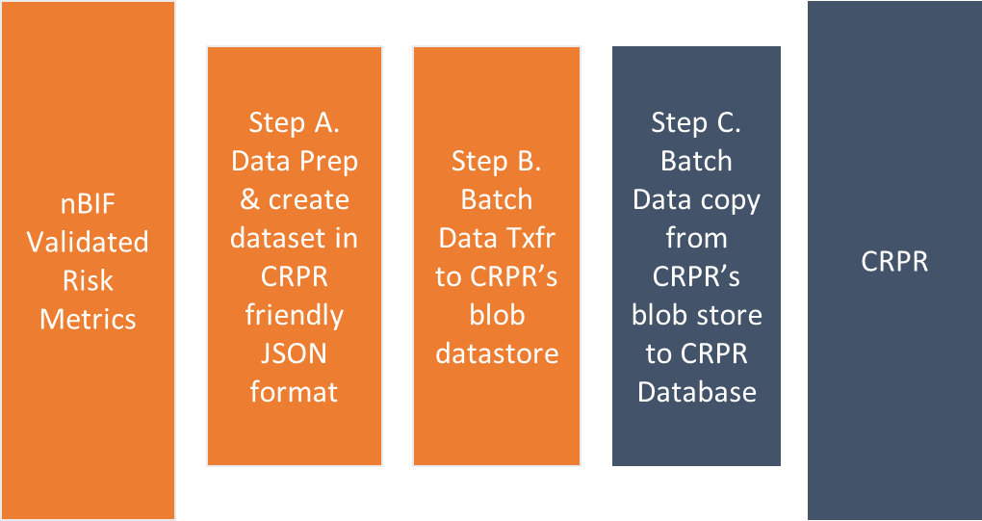
5.1.1 Application Architecture decisions
Go back to the Application Architecture decisions List
AAD-1. nBIF will deliver(push) model output dataset to CRPR in Batch manner (not through CRPR’s online API).
Decision | nBIF will deliver(push) model output dataset to CRPR in Batch manner (not through CRPR’s online API). Credit Core will take responsibility to load this batch dataset to CRPR.
Rationale | CRPR’s online API which uses micro-batching is not fit for Batch run purposes. This approach decouples nBIF and CRPR from the hard dependencies on each other..
Related IT-principle | Ensure Manageability Design for stability Segregate to reduce Impact
Consequences | CRPR need to build additional functionalities to accept and load batch data.
Alternatives | Stay with CPPR’s API solution - This solution was built with online use tests in mind and isn’t well suited for batch.
Architectural Fit | Good
Mitigations | The batch Data load process from blob store with required transformation to map current calculator output to multiple versions of Generic model output. The business (transformation) rules applied for batch will be exactly same as in the WebApp.
4. Information
Notes:
List all architectural decisions regarding the overall architecture. Please use the following way of thinking: describe the decision, give the reasoning why, describe the consequences and describe mitigations.
It is left to the discretion of the architect whether or not (s)he wants to put 1 decision per slide or more (max 2)

Slide 48
5.1.2 Application Architecture decisions
Go back to the Application Architecture decisions List
AAD-2. nBIF will directly write model output to CFO-Hub database without using RFTM route.
Decision | nBIF will directly write model output to CFO-Hub database without using RFTM route. The new setup will use Azure data factory & the central SHIR (Shared hosted integrated runtime) for TCA that is managed by CAS core.
Rationale | Since both applications are based on MS SQL server, It is more operationally efficient for CFO-Hub & nBIF. It avoids need to serialize model output into a file and then de-serialize. It also avoids, need to do additional validation at CFO Hub.
Related IT-principle | Keep IT simple
Consequences | CFO-Hub need to expose its staging-in layer for write. nBIF needs to build the data pipeline. nBIF needs to build mechanism to trigger subsequent CFO-Hub workflow on TSW z/os.
Alternatives | Continue generating the extract of model output and send it via RFTM – when data provider and data consumer are on same technology, a more effective solution is to write directly using Azure data factory,
Architectural Fit | Good
Mitigations | TWS z/OS schedule is exposed as rest api through Kong API gateway. nBIF will call TWS’s Rest API upon completion of successful data write.
4. Information
Notes:
List all architectural decisions regarding the overall architecture. Please use the following way of thinking: describe the decision, give the reasoning why, describe the consequences and describe mitigations.
It is left to the discretion of the architect whether or not (s)he wants to put 1 decision per slide or more (max 2)

Slide 49
5.1.3 Application Architecture decisions
Go back to the Application Architecture decisions List
AAD 3. The SQLs to acquire data from GRFD to nBIF shall not apply any business rules – they can only do joins and filters.
Decision​ | The SQLs to acquire data from GRFD to nBIF shall not apply any business rules, they can only do joins and filters. nBIF Staging data store is its raw data zone, there the column name and underlying values shall be kept exactly as in GRFD. When a business rule (harmonization) is a must-have and it neither fits in GRFD nor in the calculator, nBIF will be used to implement them as last resort. Within nBIF these harmonisations shall be done as part of data preparation step of the models.
Rationale​ | As part of the Recalibrated Architecture of GRFD (GO2) the function of harmonization in the chain is significantly reduced within GRFD. Also, As IFRS9 & Stress testing move to nBIF, certain harmonization that is currently been done in STIB shall also relocate. Priority will be to do the harmonization in GRFD or in the Model but when both option doesn’t suit, nBIF can be used to apply those harmonization as third most suited place. When a very high amount of data is used to lookup to extract small amount of data, for ex – corporate transaction data lookup based on Siebel id, It may bring significant performance benefit if such operations are done in-db than in-model.
Related IT-principle​ | Keep IT Simple​
Consequences​ | -
Alternatives​ | all harmonization, that are not good fit in CAS, must be done in GRFD – It doesn’t align with recalibrated architecture of GRFD2. Also, harmonization between 2 models in the n-Bridge can’t be done outside nBIF & CAS duo all harmonization, that are not done in GRFD, must be done in CAS – Certain harmonisations are much more performant when done in-db. Some harmonization may be portfolio specific while the related model could be central. For ex- Basel IV model require different harmonization across portfolios. all harmonization, that are not done in GRFD or CAS, must be done in CADDI – CADDI is our data retrieval platform that work as stateless compute. It isn’t a place to apply any business logic. Also, harmonization b/w 2 models in the n-Bridge can’t be done outside nBIF & CAS duo
Architectural Fit​ | Good​
Mitigations​ | ​
4. Information
Notes:
List all architectural decisions regarding the overall architecture. Please use the following way of thinking: describe the decision, give the reasoning why, describe the consequences and describe mitigations.
It is left to the discretion of the architect whether or not (s)he wants to put 1 decision per slide or more (max 2)

Slide 50
5.1.4 Application Architecture decisions
Go back to the Application Architecture decisions List
AAD-4. A common Data Cache is introduced to enable hosting data files that are reused by multiple nBIF instances
Decision | nBIF common Data Cache will allow hosting datasets that are used by multiple portfolios instances of nBIF In a nutshell, it is same as “Staging layer” of a specific nBIF, with main difference is that this will be readable by every nBIF instance on nBIF platform. Which dataset to be stored in the Common data cache will be decided case-by-case. Scenario Packages (that is used by ST for each portfolio) can be a good example. Another good example could be Txn & Balances data which is ingested once and used by multiple portfolios.
Rationale | Do not move large dataset to many systems, Ingest once, store once, Read by multiple applications IFRS9 and ST reuse multiple input data across different portfolios RSME & Corporate both require same set of Txn & Balance data which is quite heavy in size
Related IT-principle | Keep IT simple
Consequences | Introduction of cross portfolio component which may become a bottleneck.
Alternatives | Portfolio specific nBIFs – Since the dataset like Macro Economic Scenarios are quite high in size and since it is reused by each portfolio, by centralizing, we optimize on data management & on effort of integration with Meister by each portfolio implementation.
Architectural Fit | Good
Mitigations | Only the infrastructure layer of common data cache will be managed by nBIF platform squad. The Cache will be extended to each portfolio nBIF implementation. The nBIF instance that build data ingestion to this Common data cache will have the ownership to that data. Depending upon the need, All other portfolio nBIFs will have limited access.
4. Information
Notes:
List all architectural decisions regarding the overall architecture. Please use the following way of thinking: describe the decision, give the reasoning why, describe the consequences and describe mitigations.
It is left to the discretion of the architect whether or not (s)he wants to put 1 decision per slide or more (max 2)

Slide 51
5.2 nBIF Application components 1/2
nBIF Platform (Orchestration Platform) : The IT system that delivers infrastructure/platform components for all nBIF instances and capabilities that are used by multiple nBIF instances.
nBIF Instance : An IT application that implements n-Bridge for a portfolio. There can be multiple instances for a portfolio to support different business purpose like “Monthly run” or “Ad-hoc run” etc. Each instance contains set of modular components. Some are specific to the models while some are generic components used for all models.
Staging data Store: Generic landing zone for data sourcing. GRFD is positioned as the strategic data source for nBIF. When GRFD cannot fulfil data needs in-time, In intermediate state, nBIF may source data from other data providers.
Model Factory: Workspace for a specific model implementation. It will host all the components that are needed to execute a specific model. Data stored in model factory is temporary.
Calculator Data Stores: will hold the model ready input data. Model calculators will use this data store directly to perform the calculation.
Results data store: where model calculator directly writes its result. This is the access zone for model result inspection. It will also hold aggregated results for Plausibility purposes.
#Miscellenious: is a placeholder component to highlight that certain models may have more components for specific needs.
Data Preparation Modules: Data logistics components that prepare model input data.
Metadata Store and Log register : generic components to hold control & log data for entire workflow of the nBIF instance.
Orchestrator: This component will be responsible to chain model calculators, data pre-processes, Inspection across the entire n-Bridge of a portfolio.
Validated Risk Metrics Store: It Stores validated risk metrics for up to 1 year of history. The results of a model is used by next model in the chain through this component. It holds data only after it is approved through inspection module.
5. Application
Notes:
Describe the main features and decisions with respect to the information architecture. The idea of these slides is to have a placeholder in this PSA where the view on the relationship between core entities like transaction, client, product, etc. can be explained from in the context of the project.
To visualize the information architecture you can use several views with business objects and explain the diagram in the text, use an alternative representation or use text only.
Topics that can be addressed on these sheets are:
What are the most important information flows affected by the project?
What are the involved business objects?
How are structures and relationships between information objects preserved?
Information can often be sourced from different systems. Why has been decided to source it from system ABC?
Ownership of the objects.
Also can be chosen to discuss the above aspects per object type (as done in the LICWID PSA).

Slide 52
5.2 nBIF Application components 2/2
Common Data Cache: Similar to Staging data Store but it is shared across all nBIF instances. It is meant to store data that is reused by multiple nBIF instances. Individual nBIF instances, RSME nBIF for example, will be able to ingest the data to Common data cache.
nBIF 365 : Unified user interface for everything related to nBIF. In additional to main features that are listed below, it will contain various small features like nBIF onboarding form, Wiki links, support related info, various stats etc.
Inspection & Sign-off module: Enables business users inspect a model run result and sign-off/reject based on plausibility reports.
Ad-Hoc Run Console: To trigger ad-hoc n-Bridge run through the UI.
Correction Module: enable data correction within nBIF. The data correction are allowed to be done inside Model factory.
5. Application
Notes:
Describe the main features and decisions with respect to the information architecture. The idea of these slides is to have a placeholder in this PSA where the view on the relationship between core entities like transaction, client, product, etc. can be explained from in the context of the project.
To visualize the information architecture you can use several views with business objects and explain the diagram in the text, use an alternative representation or use text only.
Topics that can be addressed on these sheets are:
What are the most important information flows affected by the project?
What are the involved business objects?
How are structures and relationships between information objects preserved?
Information can often be sourced from different systems. Why has been decided to source it from system ABC?
Ownership of the objects.
Also can be chosen to discuss the above aspects per object type (as done in the LICWID PSA).

Slide 53
5.3 Key data Management principles for nBIF
Key data management principles
(that we defined for nBIF Data Stores)
Rational for the principle
(that we considered)
Model Factory: (Calculator & Result data store)
Use Data Mesh like architecture to organize Model factories.
This approach enables responsibility for model specific application processes to be in the control of the respective business value stream (model implementation squad).
Although n-Bridge connects all bridges together, the individual bridges shall be able to perform their DTAP lifecycle independently.
n-Bridge will have one single Business process for all bridges. However, due to various practical reasons (e.g. Ad-hoc run, operational reasons), n-Bridge shall be able to run a single bridge or be able to connect different version of bridges.
Staging data stores :
Use staging data store to ingest consolidated input data to run entire n-Bridge of a portfolio..
Store operational history of model inputs.
Currently there is significant amount of duplicate input data is ingested by Models. With nBIF, the SIS will be streamlined to combine the data contracts to a minimum.
Model input validation is required by multiple models.
Common Data Cache :
Use common data cache as staging data store for the data sets that are used by multiple n-Bridges.
Do not use it for smaller datasets.
While a portfolio wise n-bridge implementation approach brings numerous benefits, it is efficient in both cost and time if each nBIF does not require to ingest the common dataset by themselves.
Validated Risk Metrics Store:
Store operational history of model results, Intermediate results and aggregated results for entire n-Bridge of a portfolio .
Default rule for storage timeline is 12 months which can be extended based on specific portfolio needs.
nBIF will enable inspection/sign-off of calculation data. Often the inspection requires comparison with the result of past 6-12 months of approved runs.
During inspection/signoff it is desired to have entire lineage of model results.
5. Application
Notes:
List all architectural decisions regarding the overall architecture. Please use the following way of thinking: describe the decision, give the reasoning why, describe the consequences and describe mitigations.
It is left to the discretion of the architect whether or not (s)he wants to put 1 decision per slide or more (max 2)

Slide 54
5.4 nBIF collaboration view
nBIF collaboration view for the batch run of credit risk models.
GRFD or “Ad-Hoc Run console” triggers the n-Bridge run.
nBIF Orchestrator (hereafter orchestrator) triggers CADDI (* for GRFD1, this step is done within nBIF ) for data ingestion from GRFD.
CADDI acquires data from GRFD and stores as parquet file in CADDI’s staging out (hereafter STO).
Orchestrator starts data ingestion workflow,
Data is loaded from CADDI’s STO to nBIF’s staging datastore
[Optional] Data is validated using Inspection module. (not applicable for GRFD1)
Orchestrator triggers Model Input data prep workflow
For first model, IRB, data ingested from GRFD will only undergo minor data preparation.
For subsequent calculators (e.g., RWA) the data ingested from GRFD is combined with outcomes of preceding calculators (e.g., IRB). Transformations are done wherever needed.
Orchestrator triggers the calculator through CAScade API with all run parameters
Model Calculator reads input data from Calculator data store of the Model factory
Common data store may also be used for few inputs. It is not shown for simplicity.
Model calculator writes results to the result datastore of the Model factory.
[Optional] Orchestrator notifies business user to start Inspection & sign-off
Business user analyses Inputs, output and intermediates using plausibility report &
If needed, Business user perform corrections/overrides to the calculation results.
When model result is signed-off, model result is persisted
Model result is copied to “Validated risk metrics store” which stores 1 year history of data.
Orchestrator repeats step D to step G for each subsequent model in n-Bridge.
The two bridges ST baseline & RAROC can run in parallel. For them, orchestrator will execute parallel set of step D to step G.
Orchestrator initiates transfer of credit risk parameters to the nBIF consumers.
CRPR
CFO Hub
MM Store (Indicative)
[Separate subsequent process outside scope of nBIF] CRPR sends its results to CFO Hub. & GRFD ingests model calculated results from CFO Hub
5. Application

Slide 55
5.5 nBIF Inbound Data Flow-Deep dive
Generic Data Ingestion Pattern: When entire data is sourced from GRFD at runtime exclusively for the calling nBIF instance:
Special Data Ingestion Patterns
When a dataset is shared by multiple portfolios (multiple nBIF instances)
A co-ordination must be established among portfolios, so that only one nBIF instance is responsible to execute sourcing of shared dataset.
1.1 When the data provider is GRFD
1.1.1 Transaction & Balance data :
CADDI itself will maintain the SQL and it will acquire & store this data in parquet format without waiting on the trigger from nBIF.
So next to step C1, nBIF orchestrator will also initiate a parallel data copy step C2 which will copy Transaction & balance data from CADDI.
This data is used by multiple portfolios, it shall be stored within common data cache. This mean C2 will copy this data to nBIF common data cache.
1.1.2 Any other data
In this situation, the only change to the generic data ingestion pattern will be in step C1, which will point to “common data cache” instead of staging datastore.
1.2 When the data provider is non-GRFD (for ex. Meister)
CADDI will not be in-between
There will be two changes to the generic data ingestion pattern. First change in step B which will directly interface to the data provider and second change in step C1, which will point to “common data cache” instead of staging datastore.
When a data provider delivers input data (ex Obvion) in file format
The data shall be delivered to nBIFs landing zone as parquet file.
For SoX compliancy, a trigger shall also be delivered containing checksum of each data file.
when input data is sourced partly from GRFD1 & partly from GRFD2.
This situation will occur as GRFD2 matures. To handle it, Step B of each generic data ingestion patterns will be used concurrently.
A. nBIF API is called to do an n-bridge run. It is the responsibility of the caller to invoke when data is available in GRFD.
B. IF GRFD2 is the data provider: nBIF triggers CADDI’s API with the SQL location to be used to extract the data
B1. CADDI reads SQL
B2. Acquire data from GRFD
B3. Stores it into CADDIs landing zone (ADLS) in parquet format.
B4. CADDI calls the callback API of nBIF.
B. IF GRFD1 is the data provider: Steps B1 to B4 remain exactly the same but they are executed by nBIF itself.
C. nBIF runs its data logistics job to load parquet file into SQL Tables of staging database.
#Note- These diagrams extend the numbering used in “nBIF collaboration view”.
5. Application
Notes:
Describe the main features and decisions with respect to the information architecture. The idea of these slides is to have a placeholder in this PSA where the view on the relationship between core entities like transaction, client, product, etc. can be explained from in the context of the project.
To visualize the information architecture you can use several views with business objects and explain the diagram in the text, use an alternative representation or use text only.
Topics that can be addressed on these sheets are:
What are the most important information flows affected by the project?
What are the involved business objects?
How are structures and relationships between information objects preserved?
Information can often be sourced from different systems. Why has been decided to source it from system ABC?
Ownership of the objects.
Also can be chosen to discuss the above aspects per object type (as done in the LICWID PSA).

Slide 56
5.6 nBIF Outbound Data Flow-Deep dive
Generic Data Delivery Pattern:
Key principles for data deliveries from nBIF
All data transfers from nBIF happen from “Validated risk-metric store” which is the data store that holds operational history of results.
Whenever nBIF delivers data in a file, (currently applicable to CRPR & Obvion)
nBIF will also deliver an extra file containing checksum of each data file – this is to ensure SoX compliancy.
This extra file also acts as the trigger or event to the subsequent system to start their process.
nBIF maintain the history of delivered data files only until the time when next month run happens.
RFTM is the choice of tool whenever nBIF delivers data in a file to an on-premise system.
Whenever nBIF write to the database of the data consumer (currently applicable to CFO Hub)
The nBIF metadata store captures all necessary logs to ensure SoX compliancy. No additional information is shared with data consumer.
An API based integration be established to inform the consumer upon successful data write. (for CFO Hub, nBIF will trigger the Rest API of CFOs TWS API).
H. Only upon completion of approved model result inspection, nBIF starts transferring results to its downstream systems.
H1. For CRPR,
nBIF generates one text file per output table containing all the rows of the table in a json format
nBIF transfers these files to CRPRs landing zone on azure (ADLS).
H2. For CFO-Hub,
nBIF directly writes to the CFO-Hub tables using Azure data factory.
#Note- These diagrams extend the numbering used in “nBIF collaboration view”.
5. Application
Notes:
Describe the main features and decisions with respect to the information architecture. The idea of these slides is to have a placeholder in this PSA where the view on the relationship between core entities like transaction, client, product, etc. can be explained from in the context of the project.
To visualize the information architecture you can use several views with business objects and explain the diagram in the text, use an alternative representation or use text only.
Topics that can be addressed on these sheets are:
What are the most important information flows affected by the project?
What are the involved business objects?
How are structures and relationships between information objects preserved?
Information can often be sourced from different systems. Why has been decided to source it from system ABC?
Ownership of the objects.
Also can be chosen to discuss the above aspects per object type (as done in the LICWID PSA).

Slide 57
5.7 Plausibility support on nBIF
nBIF will provide a structured approach to validate the input data and the model results.
#Note- This diagram extend the numbering used in “nBIF collaboration view”.
Input Data Plausibility
C1. Input data is ingested to Staging datastore.
C1a. Input data is aggregated to derive the KPIs/KRIs for trend analysis & stored within Staging datastore
C2. Business user access Plausibility report via inspection module to validate whether Input data is as per expected trend.
C2a. Plausibility report uses the pre-aggregated input data to generate the insights
Output Data or Model Result Plausibility
E2. Calculator writes its results to the Result Datastore of the respective model factory. Result shall also include all the intermediates required for plausibility.
E2a. Calculator result is aggregated to derive the KPIs/KRIs for trend analysis & stored within Result datastore
F1. Business user access Plausibility report via inspection module to validate whether Model result is as per expectation & within threshold limits.
F1a. Plausibility report uses the pre-aggregated data of the current run to generate the insights
F1b. Plausibility report also uses the pre-aggregated data of the previous approved runs to generate the insights
G1. Upon approval of the current run, The calculator O/P, Intermediates and aggregated calculator O/P is written to “Validated Risk metric store” to support the inspection of subsequent month runs.
5. Application

Slide 58
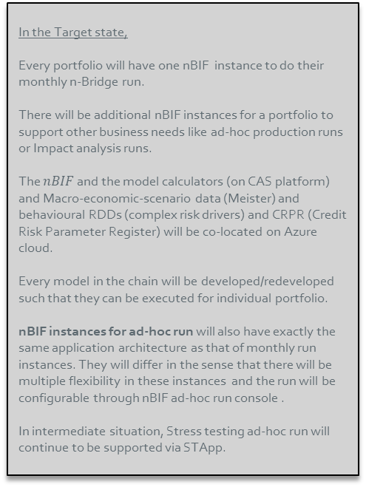
5.8 nBIF Target Application Architecture 1/2
End-to-End n-Bridge implementation for a portfolio
In the Target state,
Every portfolio will have one nBIF instance to do their monthly n-Bridge run.
There will be additional nBIF instances for a portfolio to support other business needs like ad-hoc production runs or Impact analysis runs.
The $nBIF$ and the model calculators (on CAS platform) and Macro-economic-scenario data (Meister) and behavioural RDDs (complex risk drivers) and CRPR (Credit Risk Parameter Register) will be co-located on Azure cloud.
Every model in the chain will be developed/redeveloped such that they can be executed for individual portfolio.
nBIF instances for ad-hoc run will also have exactly the same application architecture as that of monthly run instances. They will differ in the sense that there will be multiple flexibility in these instances and the run will be configurable through nBIF ad-hoc run console .
In intermediate situation, Stress testing ad-hoc run will continue to be supported via STApp.
5. Application
Notes:
Describe the main features and decisions with respect to the information architecture. The idea of these slides is to have a placeholder in this PSA where the view on the relationship between core entities like transaction, client, product, etc. can be explained from in the context of the project.
To visualize the information architecture you can use several views with business objects and explain the diagram in the text, use an alternative representation or use text only.
Topics that can be addressed on these sheets are:
What are the most important information flows affected by the project?
What are the involved business objects?
How are structures and relationships between information objects preserved?
Information can often be sourced from different systems. Why has been decided to source it from system ABC?
Ownership of the objects.
Also can be chosen to discuss the above aspects per object type (as done in the LICWID PSA).

Slide 59
5.8 Data flow numbers declared 2/2
Id. | source | target | Description of data | Change
1 | CFO Hub | GRFD | Data Sourcing from golden sources to Risk & Finance | Existing
2 | GRFD | CEE | Input data to calculate Collateral Eligibility | New
3 | CEE | CRPR | Result of Collateral Eligibility engine | New
4 | CRPR | CDM | Result of Collateral Eligibility engine | New
5 | CDM | CFO Hub | Result of Collateral Eligibility engine | New
6 | CFO Hub | GRFD | Result of Collateral Eligibility engine | New
7 | GRFD | CADDI | Conslidated input dataset from GRFD | New
8 | CADDI | nBIF Instance | Conslidated input dataset from GRFD to run entire nBridge chain | New
9 | Meister | nBIF Instance | Macro economic scenarios | New
10 | nBIF | CAS IRB | Outbound - Model data set to execute IRB calculator Inbound: IRB model result | Exist for few portfolios, New for rest
11 | nBIF | CAS IFRS9/ECL | Outbound - Model data set to execute IFRS9 calculator Inbound: IFRS9 model result | New
12 | nBIF | CAS RWA | Outbound - Model data set to execute RWA calculator Inbound: RWA model result | Exist for few portfolios, New for rest
13 | nBIF | CAS SA-RWA | Outbound - Model data set to execute SA-RWA calculator Inbound: SA-RWA result | Exist for few portfolios, New for rest
14 | nBIF | CAS RAROC | Outbound - Model data set to execute RAROC calculator Inbound: RAROC model result | New
15 | nBIF | CAS ST Baseline | Outbound - Model data set to execute ST calculator Inbound: ST model result | New
16 | nBIF | CRPR | Verified risk metrics for IRB, RWA & RAROC | Exist for few portfolios, New for rest
17 | nBIF | CFO Hub | Verified risk metrics for IFRS9, Stress Testing | Exist for few portfolios, New for rest
18 | nBIF | MM Store | Verified risk metrics for IRB, RWA, IFRS9, Stress Testing & RAROC | New
5. Application
Notes:
The above table:
lists all affected information flows
should record (potential) deviations from approved interfacing patterns
should give a high level description of interfacing patterns used (e.g batch over MQFT/SFTP, msg over WS/MQ, etc)
should highlight critical or sensitive interfaces
Include current state and project end state in this diagram using the change field to highlight new, changed or removed components.

Slide 60
5.8 Generic Target Application Architecture UT5/UT6
#Note- This diagram extend the numbering used in “Target Application Architecture of nBIF”.
8. nBIF Ingests Monthly client data as well as the Transactions and Balance data from CADDI
Transactions and Balance data from CADDI is ingested by one portfolio and used by following portfolios. Ex – Corporate nBIF workflow copies Txn & Bal data. When RSME workflow runs it doesn’t perform Txn & Bal data copy.
8a. Ingested data is inspected through Input plausibility report. This inspection consolidates validation needed by all bridges.
10a. IRB model factory is loaded with the IRB input data
10b. IRB calculator executes by reading input data from IRB model factory.
Txn & Balance data remain in Common Data Cache itself. Calculator reads it
from there.
10c. IRB calculator writes results to IRB model factory.
10d. ETL to prepare aggregates for IRB Plausibility report
10e. IRB result inspection. #Note- RWA run doesn’t wait for IRB calculator.
12a. ETL to load RWA model factory with the RWA input data
12b. RWA calculator executes by reading input data from RWA model factory.
12c. RWA calculator writes results to RWA model factory.
12d. ETL to prepare aggregates for RWA Plausibility report
12e. RWA result inspection.
12f. If IRB & RWA, both, are approved after inspection, The data from result & agg tables of both model factories is copied to Validated risk metrics store.
5. Application
Notes:
Describe the main features and decisions with respect to the information architecture. The idea of these slides is to have a placeholder in this PSA where the view on the relationship between core entities like transaction, client, product, etc. can be explained from in the context of the project.
To visualize the information architecture you can use several views with business objects and explain the diagram in the text, use an alternative representation or use text only.
Topics that can be addressed on these sheets are:
What are the most important information flows affected by the project?
What are the involved business objects?
How are structures and relationships between information objects preserved?
Information can often be sourced from different systems. Why has been decided to source it from system ABC?
Ownership of the objects.
Also can be chosen to discuss the above aspects per object type (as done in the LICWID PSA).

Slide 61
5.8 Generic Application Architecture UT9
This page provides simplistic overview of high level orchestration steps to run IFRS9 on nBIF. It is not intended to cover all the nuiances.
See Decision document IFRS9 migration to nBIF v1.0.pptx cover more granular details about IFRS9 on nBIF.
#Note- This diagram extend the numbering used in “Target Application Architecture of nBIF”.
8. nBIF Ingests Monthly client data from CADDI. nBIF also ingest MES from Meister.
#Note- IFRS9 require data from few other data providers. The study about that is in progress. See sub-heading.
8a. Ingested data is inspected through Input plausibility report. This inspection consolidates validation needed by all bridges.
10. IRB calculator run is complete with data exchange from IRB Model Factory.
11a. ETL to load IFRS9 model factory with the IFRS9 input data
#Note – It is a simplistic diagram. It can be multi step process to prepare Input data.
11b. IFRS9 calculator executes by reading input data from IFRS9 model factory & Common Data Cache.
11c. IFRS9 calculator writes results to IFRS9 model factory.
#Note – There can be multiple sub-steps here, which will be detailed out in low level design of IFRS9.
10d. ETL to prepare aggregates for IFRS9 Plausibility report
10e. IFRS9 result inspection.
#Note- Decision Pending – Whether RWA run will start only after IFRS9 approval.
12. RWA calculator run is complete with data exchange from RWA Model Factory.
#Note- Do note, with B4, RWA is to be calculated with IRB approach as well as SA for every portfolio. It is likely to have single RWA B4 calculator for both.
12f. If IRB & IFRS9 & RWA, all, are approved after inspection, The data from result & all tables of all three model factories is copied to Validated risk metrics store.
5. Application
Notes:
Describe the main features and decisions with respect to the information architecture. The idea of these slides is to have a placeholder in this PSA where the view on the relationship between core entities like transaction, client, product, etc. can be explained from in the context of the project.
To visualize the information architecture you can use several views with business objects and explain the diagram in the text, use an alternative representation or use text only.
Topics that can be addressed on these sheets are:
What are the most important information flows affected by the project?
What are the involved business objects?
How are structures and relationships between information objects preserved?
Information can often be sourced from different systems. Why has been decided to source it from system ABC?
Ownership of the objects.
Also can be chosen to discuss the above aspects per object type (as done in the LICWID PSA).

Slide 62
Infrastructure
n-Bridge Information Factory
6. Infrastructure

Slide 63

6.1 Cloud principles
Architecture Cloud Technology Principles
1
Allow all business processes to use public Cloud
2
Actively use Cloud technology to enable innovation and radical automation
4
Follow Cloud technology standards
5
Use SaaS before PaaS before IaaS
6
Treat public Cloud as (out) sourcing
Keeping up with the pace of change
3
10
7
8
Develop Cloud native
Lean aggregation of IT operations data
Cloud exits to Cloud
Prepare for exit
Secure, compliant and in control by design
9
6. Infrastructure

Slide 64
6.2 Technology choices
Component | Functional Description | Technology
Staging Data Store | Landing zone for all data providers of an nBIF Instance | Azure SQL
Calculator data Stores | Model Specific data store the calculator uses as a data source | Azure SQL
Results data store | Model Specific data store the calculator uses to write results. It is also used to prepare aggregated data for plausibility. | Azure SQL
Metadata Store and Log register | Database to store logs & operational metadata of an nBIF Instance | Azure SQL
Validated Risk Metrics Store | Datastore that stores operation history of approved model results including aggregates of an nBIF Instance | Azure SQL
Common Data Cache | Datastore that stores significant datasets that are used by multiple nBIF Instance | Azure SQL
Data Logistics Module | ETL to combine, integrate & move data between internal & external data stores. Ex- RWA Input data preparation from Staging and IRB Results Data store; Data Delivery from nBIF Validated Risk Metrics Store to consumers data store. | Azure Data Factory
Orchestrator | Top level orchestrator for every nBIF implementation. For ex- starting an n-bridge run ; Initiating data preparation; Triggering calculator ; Pushing the results to data consumers | Logic App (Standard) for all top level orchestration
nBIF 365 – Generic User interface Applicable to all subcomponents | Unified user interface for everything related to nBIF. This include, Inspection & Signoff module, Correction Module, Ad-hoc run console, nBIF onboarding form, Wiki links, support related info, various stats etc. | Azure WebAPP , HTML, CSS, Blazor .Net web framework, Application Gateway,
nBIF 365 – Inspection & Sign-off | Allowing inspection and signoff of calculator results.The inspection can be in the form of Manual data access and querying. Structured inspection reports eg. Plausibility report for KC2a The sign-off event shall kick-off subsequent processes in the n-Bridge. | Direct data access for add-hoc queries – Decision deferred to next plateau Embedded PowerBI report for structured inspection Logic App API for triggers
nBIF 365 – Correction Module | Allowing modification/overrides to model calculated risk parameters | Decision deferred to next plateau
nBIF 365 – Ad-hoc run console | Allowing business users to trigger customized n-bridge run from nBIF 365 GUI. | Decision deferred to next plateau
6. Infrastructure
Notes:
On this slide list the technology choices that have been made.

Slide 65
Migration
n-Bridge Information Factory - MVP
7. Migration

Slide 66
7.1 Implementation & Migration approach
nBIF implementation for the monthly batch run for each TCA portfolios
On-boarding of portfolio specific nBIF implementation to Rabobank application Landscape – Activities of portfolio areas
Set up a new team for this application and set up the overall governance
Register the new application in CMDB and perform all assessments like CRAT, Cloud on boarding, etc.
Significant amount of steps can be excluded because they are covered by implementation of nBIF platform.
Among remaining steps a great percentage of the steps can be reused from RSME nBIF implementation.
Finish the pre-ready analysis and agree on the MVP requirements
Create an initial backlog with an MVP
Create Data contracts, SIS and data model for nBIF, wherever applicable
Build pipeline for the data ingestion for the IRB & RWA models from GRFD.
Create necessary interfaces and build orchestration flow
Perform parallel run with current on premise calculators to do user acceptance test & performance test
Build pipeline to provide calculated results to CFO Hub & CRPR.
Replace or replicate or simply repoint current IRB & RWA Plausibility report to nBIF
7. Migration

Slide 67
Risk
n-Bridge Information Factory
8. Risk

Slide 68
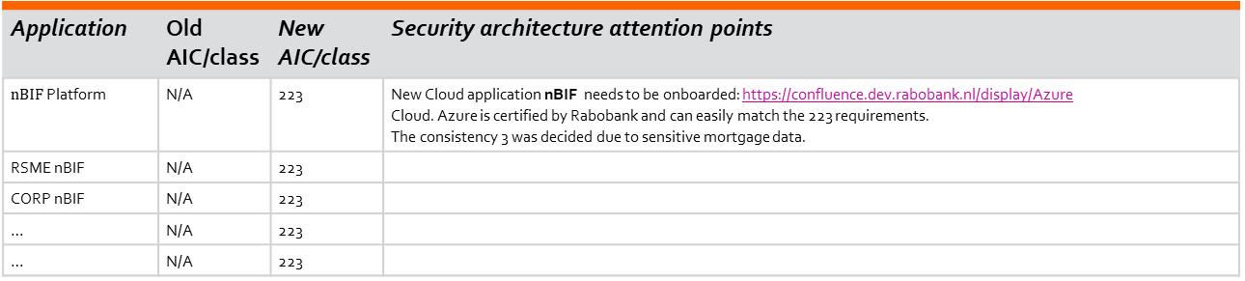
8.1 Security
Application | Old AIC/class | New AIC/class | Security architecture attention points
$nBIF$ Platform | N/A | 223 | New Cloud application nBIF needs to be onboarded: https://confluence.dev.rabobank.nl/display/Azure Cloud. Azure is certified by Rabobank and can easily match the 223 requirements. The consistency 3 was decided due to sensitive mortgage data.
RSME nBIF | N/A | 223
CORP nBIF | N/A | 223
… | N/A | 223
… | N/A | 223
RSF | Rabobank Security Framework | Impact on relevance of enterprise (security) architecture standards
AIC | AIC classification process | Risks mitigated according to AIC rate 2-2-3
SSB | System Security baseline(s) ( assessment) | TBD
RRS | Residual Risk statement | TBD
* this name must be in line with the CMDB: System code (RN) or Global Application Name (WRR)
For the involved security officer see 10.2 Project reference and sign-off
8. Risk
Notes:
This section only applies to the project end situation. It explains how certain significant non functional requirements are solved in the application architecture. List the outcome of the Security Risk Classification for the involved applications and the related architecture points/decisions from a security point of view
GENERAL
< Security viewpoint >
Solution uses external cloud: <Yes/No> (In case cloud is used a cloud notification must be done (fm.nl.rrs.cloudregistration <cloudregistratie@rabobank.nl>)
Security specifics:
Append, for example:
Contains privacy sensitive information.
Protection principles for Data at rest, in transit and in Use (see Excel)
Usage of standard security infrastructure
IAM –
Authentication mechanism
user provisioning and authorizations
Logging & monitoring & alerting
Privileged account management (e.g CyberArk)
Autorization assumptions
Definition of privileged access
Principles for an orderly authorization model
Functional accounts
Test environments
Responsible and representative testing
Security testing
Pentests necessary?
Static Code Analysis

Slide 69
8.1 Security
Identity and Access Management
nBIF will reuse the enterprise defined user identities that are maintained using Azure Active directory.
Users can have multiple roles
New NPAs with privileged access will be defined to perform automated production runs and read-write to nBIF data stores.
AD groups be defined to support individual use cases
This makes it easy to assign roles to multiple users who interact with nBIF application for same use-case and require common privilege
Users
Roles
Groups
Permission
IAM
constructs
for nBIF
Multiple roles will be defined to support different user personas including, but not limited to, developer, analysts, support team etc.
Portfolio or/and bridge specific roles will also be created to limit data access. This will be specially needed for the portfolios which have stringent data confidentiality requirements outside their portfolios. For ex – Obvion.
Permissions are about access to resources like read/write/view/admin
Permissions will be given to Roles
For all client based interaction with nBIF components, single sign on will be implemented.
For Perimeter security, Underlying platform security, and Data security, nBIF will implement CCC recommended general guidelines.
8. Risk
Notes:
This section only applies to the project end situation. It explains how certain significant non functional requirements are solved in the application architecture. List the outcome of the Security Risk Classification for the involved applications and the related architecture points/decisions from a security point of view
GENERAL
< Security viewpoint >
Solution uses external cloud: <Yes/No> (In case cloud is used a cloud notification must be done (fm.nl.rrs.cloudregistration <cloudregistratie@rabobank.nl>)
Security specifics:
Append, for example:
Contains privacy sensitive information.
Protection principles for Data at rest, in transit and in Use (see Excel)
Usage of standard security infrastructure
IAM –
Authentication mechanism
user provisioning and authorizations
Logging & monitoring & alerting
Privileged account management (e.g CyberArk)
Autorization assumptions
Definition of privileged access
Principles for an orderly authorization model
Functional accounts
Test environments
Responsible and representative testing
Security testing
Pentests necessary?
Static Code Analysis

Slide 70
Impact on Operations
n-Bridge Information Factory
9. Impact on Operations

Slide 71
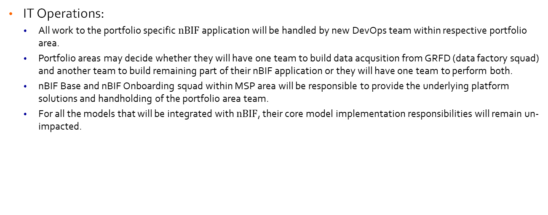
9.1 Impact on IT Operations
IT Operations:
All work to the portfolio specific $nBIF$ application will be handled by new DevOps team within respective portfolio area.
Portfolio areas may decide whether they will have one team to build data acqusition from GRFD (data factory squad) and another team to build remaining part of their nBIF application or they will have one team to perform both.
nBIF Base and nBIF Onboarding squad within MSP area will be responsible to provide the underlying platform solutions and handholding of the portfolio area team.
For all the models that will be integrated with $nBIF$, their core model implementation responsibilities will remain un-impacted.
9. Impact on Operations

Slide 72
9.2 Impact on IT Operations
Data Disclosure SQUAD
nBIF Base SQUAD
Build & Maintain central features like nBIF 365 (UI, Inspection & Signoff module, Ad-hoc run console), Metadata framework.
Build & Maintain common data cache including support for pipelines to load data to this component.
Develop practices to ensure secure, reliable & scalable azure environment for all nBIF applications.
Govern cloud compliancy, nBIF standards, Data management standard (like EDC/IDQ) across all nBIF application.
Create, Maintain & Expose data retrieval service from GRFD2.
Maintain staging out file system on azure.
The point of contact for GRFD technical interface.
nBIF Onboarding SQUAD
Handhold portfolio area squads in their nBIF implementation journey and be the trusted partner to answer all how-tos.
Provide training about nBIF standards, way of working, Metadata framework, Data Management Framework etc.
Perform nBIF onboarding, Build skeleton environment for <portfolio> nBIF, provide necessary accesses.
Review <portfolio> nBIF implementation
Data Foundation SQUADs
Portfolio Area Squad(s)
Calculator SQUADs
Own Data Acquisition from GRFD
Build SQL query to extract data from GRFD’s RDV/BDV/Dal layer.
Define DQ checks needed on extracted data
Deploy SQl query to <portfolio> nBIF application.
Extend SQL query & dq checks upon addition of new bridges to nBIF.
Build Input validation plausibility reports.
Build portfolio wide LDDs and CRR
Quality check of model specific PDDs
Own <Portfolio> nBIF application
onboard <portfolio> nBIF application to Rabobank landscape.
CRAT, SSB, Application role, CI registration, pIA
Access control, etc
Build end to end orchestration using LogicAPP
Build Data logistics including ETL for model data preparation, ETL for data delivery to consumers, ETL for data acquisition from non-GRFD data sources (like Meister for IFRs9)
Prepare data (like aggregates) for Plausibility reports
Build data logistics to CRPR, CFO-Hub etc
Support Incremental changes
Support UAT runs & production run
Build and maintain model specific input & output PDDs
Creating Power BI Plausibility reports for their model
Inspecting the model results and providing sign-off.
load complete data needed to build model ready input into GRFDs RDV/BDV/Dal layer.
trigger nBIF application upon availability of data.
Handhold Data Factory Squad in working with GRFD’s SAP HANA DB.
Activities 1-5 are applicable when CA does the STO. For Corporate, Data Factory SQUAD is handling these activities.
A decision is differed to portfolio area’s on how they organize their squads to support all the above activities.
9. Impact on Operations

Slide 73
Document Control
n-Bridge Information Factory
10. Document Control

Slide 74
10.1 Version history
Date | Version | Status | Changed by | Summary of changes
29-11-2021 | 1.0 | Approved | Prabhat Kumar | Approved version Processed review remarks from architecture board
15-06-2023 | 1.5 | DRAFT | Prabhat Kumar | Initial Draft
27-07-2023 | 1.6 | DRAFT | Prabhat Kumar | Updates + Change against Initial review feedback of Guido Helder and Harry Coopmans on v1.5
18-08-2023 | 1.7 | DRAFT | Prabhat Kumar | Updates with peer review feedbacks
07-09-2023 | 1.71 | DRAFT | Prabhat Kumar | Tribe Credit Analytics architecture board -- Discussion
21-09-2023 | 1.9 | DRAFT | Prabhat Kumar | Tribe Credit Analytics architecture board – Approved with minor remarks
22-09-2023 | 2.0 | Approved | Prabhat Kumar | Incorporated architecture board remarks.
10. Document Control

Slide 75
10.2 Change reference and sign-off
Change name | Project code | PID reference
Extend nBIF PSA to be generic for all portfolios and all model bridges | <project code> (UT/LDN only) | <PID url>
Name | Role | Date | Approved | Consulted | Informed
Tribe Credit Analytics & Tribe Credit Core Architecture board | Domain Architecture board* | 2023-09-21 | Yes
Tribe Credit Analytics & Tribe Credit Core Architecture board | Domain Architecture board* | 2023-09-07 |  | Yes
Harry Coopmans | Managing Business Architect – Tribe Credit Analytics | 2023-09-01 |  | Yes
Guido Helder | Business Architect – Tribe Credit Analytics | 2023-09-01 |  | Yes
Aaron Van Dam | Solution Architect – Model Support platform | 2023-09-01 |  | Yes
Ramdaras, UD (Umesh) | Business consumer | 2023-09-01 |  | Yes
Murre, WJ (Wim) | Product owner | 2023-09-01 |  | Yes
Vishal Parashar | Solution Architect – Stress testing |  |  | Yes
Lopez Toonen, VA (Victor) | Business Architect – Tribe Credit Analytics |  |  | Yes
Moorman, R (Rick) | Business Architect – Tribe Credit Analytics |  |  | Yes
Eerdt van, GLM (Gerard) | Solution Architect – Corporate |  |  | Yes
* PSAs are approved in the domain architecture board. Overarching initiatives are attuned between domain architecture boards. For large and/or complex initiatives the PSA can be attuned in the enterprise architecture board.
10. Document Control
Notes:
If another domain/region is impacted by the project, the domain/regional architect is considered as a co-author of the document. This architect will be on the approval list to sign off the document.
Obtain your approvals before submitting to the board and reflect this by filling in the approval dates.
The project code is used for the IT Risk management reporting process. Currently only applies to UT/LDN projects.

Slide 76
10.2 Change reference and sign-off
Change name | Project code | PID reference
Extend nBIF PSA to be generic for all portfolios and all model bridges | <project code> (UT/LDN only) | <PID url>
Name | Role | Date | Approved | Consulted | Informed
Cammen van der, MA (Michael) | Solution Architect, RMM |  |  | Yes
Bhadani, N (Niharika) | Solution Architect, SL&I |  |  | Yes
Maheshwari, AA (Abhishek) | Business Architect, Tribe Data Foundation |  |  | Yes
Al-Dabbash, M (Moawya) | Solution Architect, GRFD1, Tribe Data Foundation |  |  | Yes
Cornelisse, N (Nico) | Solution Architect, CFO Hub, Tribe Data Foundation |  |  | Yes
Savenije, M (Mathijs) | Solution Architect, Tribe Credit Core |  |  | Yes
Joosten, EFM (Evi) | Solution Architect, GRFD2, Tribe Data Foundation |  |  | Yes
Harpude, K (Kiran) | Solution Architect, GRFD2, Tribe Data Foundation |  |  | Yes
* PSAs are approved in the domain architecture board. Overarching initiatives are attuned between domain architecture boards. For large and/or complex initiatives the PSA can be attuned in the enterprise architecture board.
10. Document Control
Notes:
If another domain/region is impacted by the project, the domain/regional architect is considered as a co-author of the document. This architect will be on the approval list to sign off the document.
Obtain your approvals before submitting to the board and reflect this by filling in the approval dates.
The project code is used for the IT Risk management reporting process. Currently only applies to UT/LDN projects.

Slide 77
General references
Document control
Architectural reference documents & templates
Name | URL
ICE PSA | https://raboweb.sharepoint.com/teams/SDARiskFinance/_layouts/15/Doc.aspx?OR=teams&action=edit&sourcedoc={F333A115-317E-4387-9B00-FA1FF832ABA6}
PSA N-Bridge v1.0.pptx | https://raboweb.sharepoint.com/:p:/r/teams/SDARiskFinance/Tribe%20Credit%20Analytics%20Architecture%20Repository/PSA%20N-Bridge%20v1.0.pptx?d=wa65da20701214251a0075daa11032057&csf=1&web=1&e=Wnmih5
S&I n-BIF architecture note V1.0.pptx | https://raboweb.sharepoint.com/:p:/r/teams/SDARiskFinance/Tribe%20Credit%20Analytics%20Architecture%20Repository/S%26I%20n-BIF%20architecture%20note%20V1.0.pptx?d=w533d660605b4485683ffb7e6ca5aecf9&csf=1&web=1&e=YqQfvX
Decision document IFRS9 migration to nBIF v1.0.pptx | https://raboweb.sharepoint.com/:p:/r/teams/SDARiskFinance/Tribe%20Credit%20Analytics%20Architecture%20Repository/Decision%20document%20IFRS9%20migration%20to%20nBIF%20v1.0.pptx?d=w67bf226d153a49258e8f993ceaeab949&csf=1&web=1&e=XFT2LN
n-Bridge Business Requirement document | https://raboweb.sharepoint.com/teams/SDARiskFinance/Shared%20Documents/ModelManagement/Topics/NBridgeBatchIF/BRD
n-Bridge Architecture decision | https://raboweb.sharepoint.com/teams/SDARiskFinance/_layouts/15/Doc.aspx?OR=teams&action=edit&sourcedoc={BE38944B-78D3-4109-9474-09BEFA319959}
Global Policy portal | https://policyhouseportal.rabonet.com/display/PP/Policy+House+Portal+Rabobank+Group
Enterprise IT Architecture Principles | https://raboweb.sharepoint.com/sites/organization-strategydataandarchitecture/SitePages/policy_and_guidance_enterprise-architecture_ea-principles-default.aspx
Architecture meta model and standard viewpoints | https://raboweb.sharepoint.com/sites/organization-strategydataandarchitecture/SitePages/way_of_working_descriptions-default.aspx
Functional Solution Design Template (WRR) | http://sharepoint.rabonet.com/sites/architecture/process/Templates/Agile%20Functional%20Solution%20Design%20Template.dotx
AIC classification | https://raboweb.sharepoint.com/sites/Topic-FirstLineRiskSecurity/Standards/Forms/AllItems.aspx?RootFolder=%2fsites%2fTopic%2dFirstLineRiskSecurity%2fStandards%2f03%2e%20Departmental%20Procedures%2fFLR&FolderCTID=0x012000FD2A25E9C374C9489F994247ED734413
Availability Classes | https://raboweb.sharepoint.com/sites/organization-strategydataandarchitecture/Shared%20Documents/Enterprise%20Architecture/EA/Vijfpuntschaal%20voor%20infrastructurele%20beschikbaarheid.pdf
Data Management Office | https://raboweb.sharepoint.com/sites/organization-strategydataandarchitecture/SitePages/Data-Management-Office-(DMO).aspx
Data Preparation Standards (Enterprise Data Programme) | https://teams.microsoft.com/l/channel/19%3Aac2458ea5a434feba91281e82510b174%40thread.skype/tab%3A%3A5c9db01f-c855-4e7e-9027-627f40201b93?groupId=fa5f53e0-8101-4397-8b6a-687b2f382fa6&tenantId=6e93a626-8aca-4dc1-9191-ce291b4b75a1
EDL Onboarding Portal (Enterprise Data Programme) | https://raboweb.sharepoint.com/teams/EDLOnboardingTeam/SitePages/Architecture.aspx

